Slide 1

Course Project MIST 6160 P 1 201 Advanced Data Mining 2022 Fall Human Activity Recognition & Restaurant Review Sentiment Analysis
Harshit Chandrol
PERSUING MASTER OF SCIENCE IN BUSINESS ANALYTICS (2ND SEMESTER)
GUIDANCE OF
PROF. PRASAD KOTHAPALLI

Slide 2






WHAT WILL WE BE DISCUSSING?
DATA
SUPERVISED
PROBLEM
OVERVIEW
LEARNING
STATEMENT
BUSINESS
EXPLORING
UNSUPERVISED
OBJECTIVE
DATA
LEARNING

Slide 3
WHAT WILL WE BE DISCUSSING?
PROBLEM
DATA
What is in the data
STATEMENT
OVERVIEW
What kind of data
Splitting the data
BUSINESS
EXPLORING
Checking data Imbalance
Feature Engineering
OBJECTIVE
DATA
T-SNE
Principal Component Analysis
Other Data Domain

Slide 4
WHAT WILL WE BE DISCUSSING?
PROBLEM
DATA
SUPERVISED
Creating functions to execute
8 algorithms
Logistic
Regression
STATEMENT
OVERVIEW
LEARNING
Linear
SVC
Kernel
SVM
BUSINESS
EXPLORING
UNSUPERVISED
Decision
Tree
K-Means
Clustering
Random Forest
Classifier
OBJECTIVE
DATA
LEARNING
Gradient
Boosted
Hierarchical
Clustering
K-nearest
Neighbor
Naïve
Bayes

Slide 5


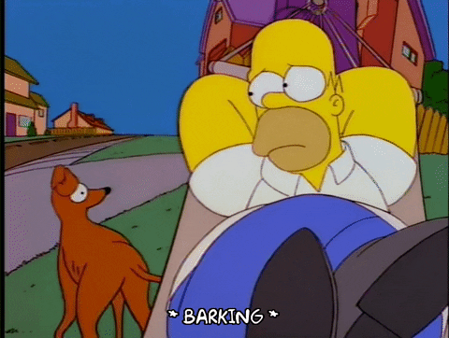
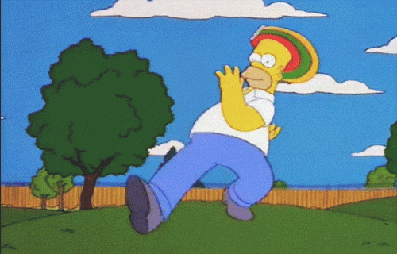


STANDING
LAYING
SITTING
PROBLEM
STATIC
STATEMENT
WALKING
WALKING UPSTAIRS
WALKING DOWNSTAIRS
DYNAMIC

Slide 6
Work on traditional machine learning to learn from the data
PROBLEM
Subsequently anticipating human action:
STATEMENT
Walking
Sitting
Laying
Standing
Walking upstairs
Walking downstairs

Slide 7
Today, in addition to utilizing smartphones, we increasingly use smartwatches.
Business
They keep the track of everything we do throughout the day
and track how many calories we expend.
Objective
Tracking the person’s movement using a gyroscope and accelerometer and using the data to create a computational program.
Software Application
Which can be turned into a mobile application to keep an eye on the movements and health

Slide 8

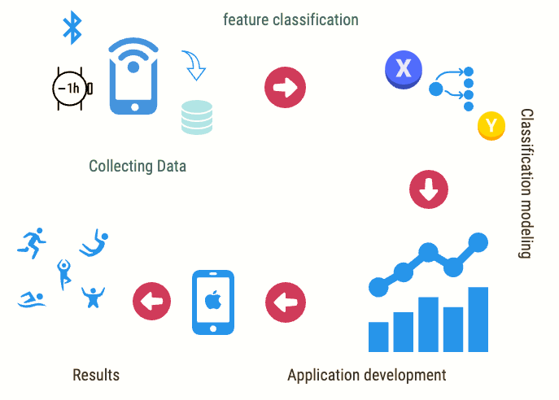
Business
Objective
Software Application

Slide 9

What is in the Data?
Includes human movement data captured using sensors.
DATA
Gyroscope
Sensing Angular
Orientation
Accelerometer
Sensing Axis
Orientation
OVERVIEW
Time & Frequency
tBodyAcc
tGravityAcc
tBodyAccJerk
tBodyGyro
tBodyGyroJerk
tBodyAccMag
tGravityAccMag
tBodyAccJerkMag
tBodyGyroMag
tBodyGyroJerkMag
Y
fBodyAcc
fBodyAccJerk
fBodyGyro
fBodyAccMag
fBodyAccJerkMag
fBodyGyroMag
fBodyGyroJerkMag
X
Z

Slide 10










What is in the Data?
30 Subjects
DATA
Age between 18-48 years
OVERVIEW
Performed 6 activities
standing, sitting, laying,
walking, walking upstairs, walking downstairs
Having smartphones (two sensors) on waist
And,
3 axial linear acceleration and 3 axial angular velocity is captures

Slide 11
What kind of Data?
Entire
563
Columns
1st
……………………
561st
562nd
563rd
Dataset
DATA
tBodyAcc-mean()-X
angle(Z,gravityMean)
Subject
Activity
Numeric [Float
(-1,1)
1
2
3
4
.
.
.
25
9
.
.
.
17
8
.
.
.
24
28
30
Standing
Sitting
Laying
Sitting
Walking downstair
Walking
Walking upstairs
Walking downstairs
Laying
.
.
.
.
.
.
.
.
.
Standing
Walking
Walking upstairs
-0.9831846
-0.9749144
-0.9636684
-0.9827498
-0.9796719
-0.9902177
-0.9660967
-0.9663132
-0.9572362
-0.9736632
-0.973948
-0.9859965
-0.982937
-0.9906873
0.28858451
0.27841883
0.27965306
0.27917394
0.27662877
0.27719877
0.27945388
0.27743247
0.27729342
0.28058569
0.27688027
0.27622817
0.278457
0.27717497
OVERVIEW
10,299
Text Categorical
Numeric Categorical
Features
Labels
Rows

Slide 12
What kind of Data?
Train
563
Columns
1st
……………………
561st
562nd
563rd
Dataset
DATA
tBodyAcc-mean()-X
angle(Z,gravityMean)
Subject
Activity
Numeric [Float
(-1,1)
1
2
3
4
.
.
.
25
9
.
.
.
17
8
.
.
.
24
28
30
Standing
Sitting
Laying
Sitting
Walking downstair
Walking
Walking upstairs
Walking downstairs
Laying
.
.
.
.
.
.
.
.
.
Standing
Walking
Walking upstairs
-0.9831846
-0.9749144
-0.9636684
-0.9827498
-0.9796719
-0.9902177
-0.9660967
-0.9663132
-0.9572362
-0.9736632
-0.973948
-0.9859965
-0.982937
-0.9906873
0.28858451
0.27841883
0.27965306
0.27917394
0.27662877
0.27719877
0.27945388
0.27743247
0.27729342
0.28058569
0.27688027
0.27622817
0.278457
0.27717497
OVERVIEW
7,352
Text Categorical
Numeric Categorical
Features
Labels
Rows

Slide 13
What kind of Data?
Test
563
561
Columns
1st
……………………
561st
562nd
563rd
Dataset
DATA
tBodyAcc-mean()-X
angle(Z,gravityMean)
Subject
Activity
Numeric [Float
(-1,1)
1
2
3
4
.
.
.
25
9
.
.
.
17
8
.
.
.
24
28
30
Standing
Sitting
Laying
Sitting
Walking downstair
Walking
Walking upstairs
Walking downstairs
Laying
.
.
.
.
.
.
.
.
.
Standing
Walking
Walking upstairs
-0.9831846
-0.9749144
-0.9636684
-0.9827498
-0.9796719
-0.9902177
-0.9660967
-0.9663132
-0.9572362
-0.9736632
-0.973948
-0.9859965
-0.982937
-0.9906873
0.28858451
0.27841883
0.27965306
0.27917394
0.27662877
0.27719877
0.27945388
0.27743247
0.27729342
0.28058569
0.27688027
0.27622817
0.278457
0.27717497
OVERVIEW
2,947
Text Categorical
Numeric Categorical
Features
Labels
Rows

Slide 14
What kind of Data?
Test
561
Columns
1st
……………………
561st
Predictions
Dataset
DATA
tBodyAcc-mean()-X
angle(Z,gravityMean)
Numeric [Float
(-1,1)
Standing
Sitting
Laying
Sitting
Walking downstair
Walking
Walking upstairs
Walking downstairs
Laying
.
.
.
.
.
.
.
.
.
Standing
Walking
Walking upstairs
-0.9831846
-0.9749144
-0.9636684
-0.9827498
-0.9796719
-0.9902177
-0.9660967
-0.9663132
-0.9572362
-0.9736632
-0.973948
-0.9859965
-0.982937
-0.9906873
0.28858451
0.27841883
0.27965306
0.27917394
0.27662877
0.27719877
0.27945388
0.27743247
0.27729342
0.28058569
0.27688027
0.27622817
0.278457
0.27717497
OVERVIEW
2,947
Features
Rows

Slide 15
Data Splitting
Train Data
Test Data
DATA
OVERVIEW
Ratio
7
3
CSV files
Rows
7,523
2,947

Slide 16
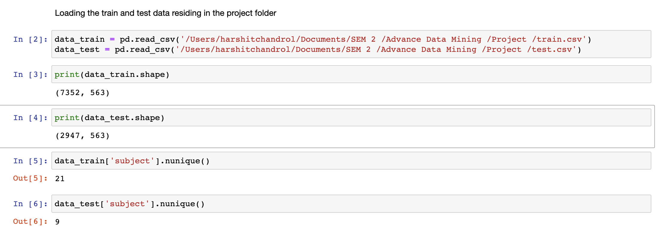
Data Splitting
Train Data
Test Data
DATA
No Duplicate values
OVERVIEW
21
9
Unique Subjects
No Null values
Code

Slide 17
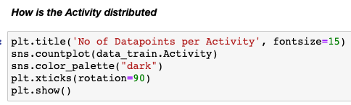
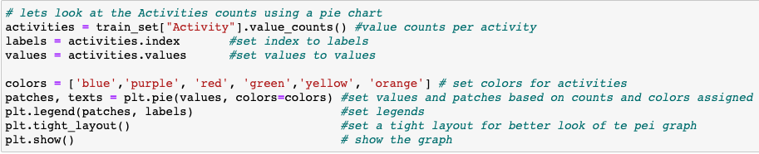
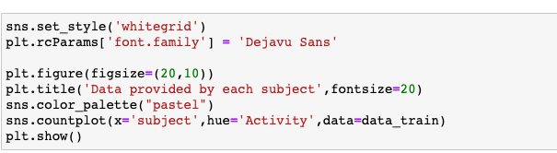
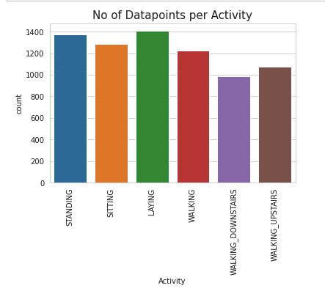
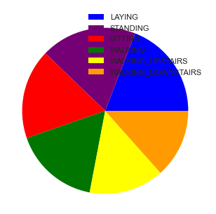
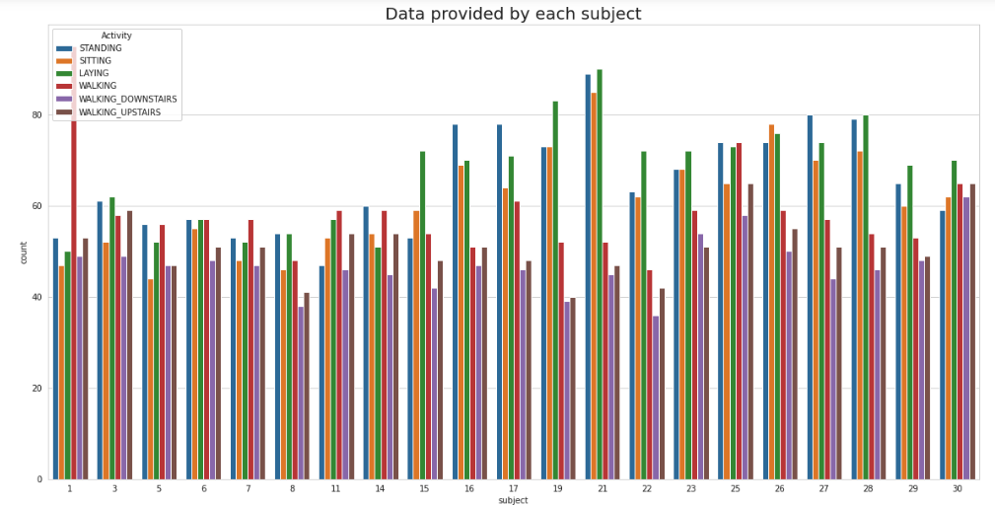
Checking Data Imbalance
Activity Distribution
Same number of observations can be seen by each subject
EXPLORING
DATA
C1
C2
C3

Slide 18
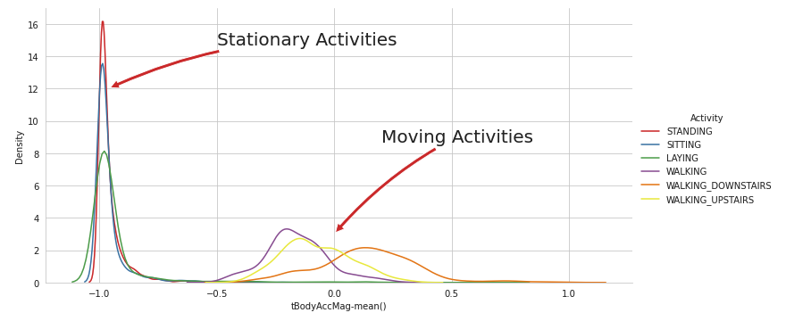
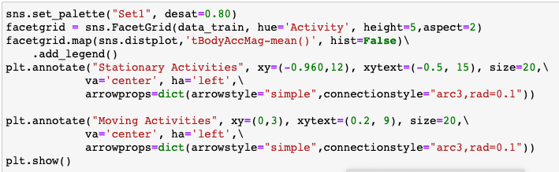
Feature Engineering
Static : Sitting, Standing, Laying
Dynamic : Walking, Walking Upstairs, Walking downstairs
Data is normally distributed with some long tails
EXPLORING
DATA
Mean of Body Acceleration Magnitude
C1

Slide 19
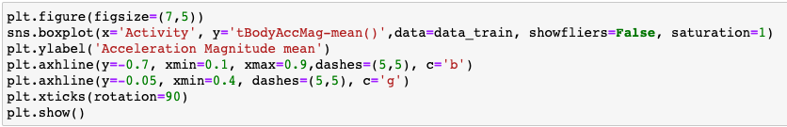
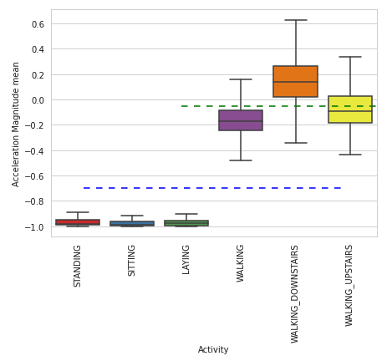
Static : Sitting, Standing, Laying
Dynamic : Walking, Walking Upstairs, Walking downstairs
Feature Engineering
Magnitude of Acceleration
EXPLORING
IF
DATA
< -0.8
> -0.6
>0.0
Standing
Sitting
Laying
Walking
Downstairs
Walking
Walking Downstairs
Walking Upstairs
We can classify 75% Activity labels with some errors
C1

Slide 20
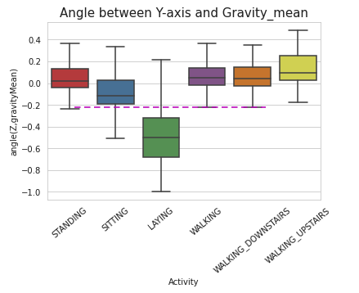
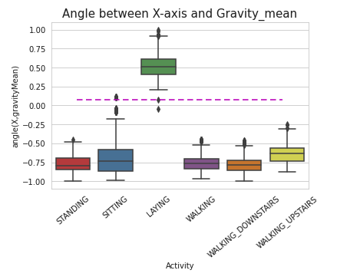
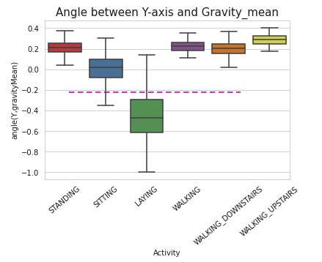
Static : Sitting, Standing, Laying
Dynamic : Walking, Walking Upstairs, Walking downstairs
Feature Engineering
Gravity Components
EXPLORING
IF
DATA
> 0
X
< -0.2
Y
<-0.2
Z
Laying

Slide 21
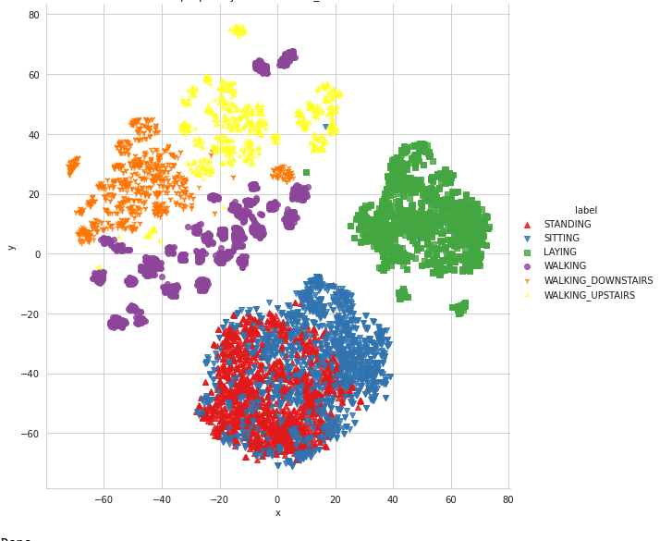
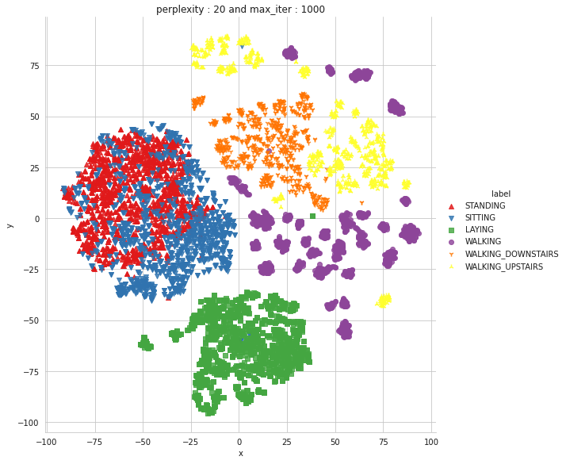
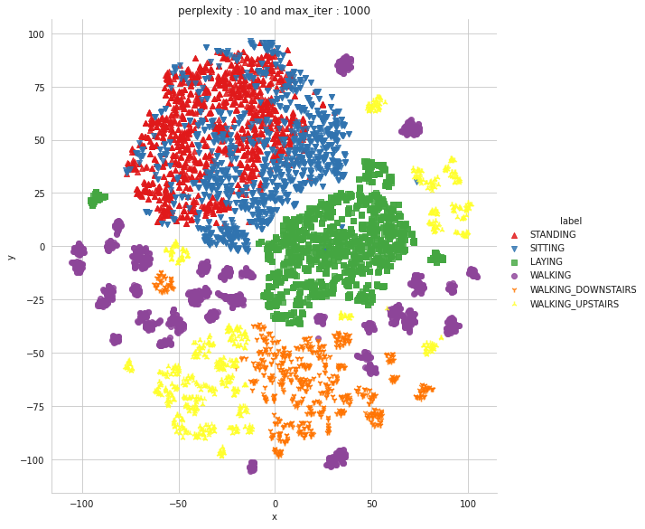
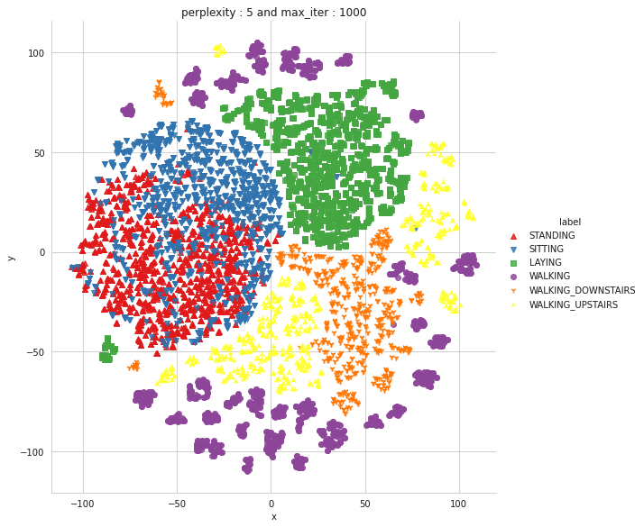
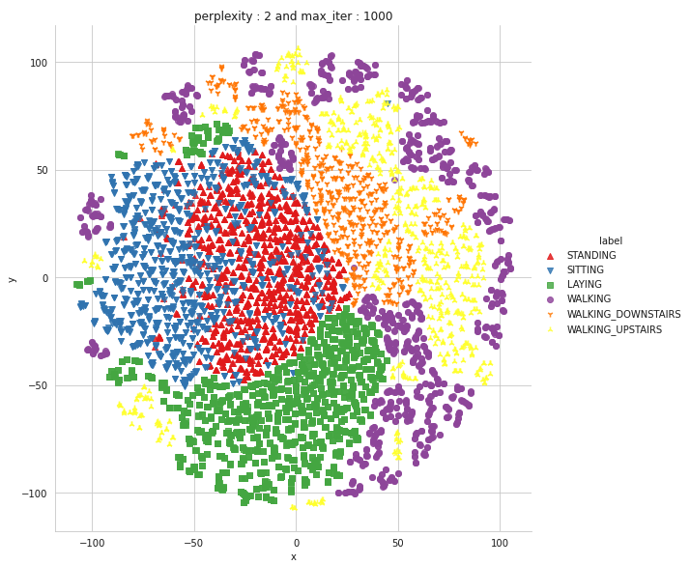
Static : Sitting, Standing, Laying
Dynamic : Walking, Walking Upstairs, Walking downstairs
T-SNE
We can apply t-SNE to understand our high dimensional data and project it into low dimensional space
perplexity
Max_iter
EXPLORING
2
1000
DATA
5
1000
10
1000
20
1000
50
1000
C1

Slide 22
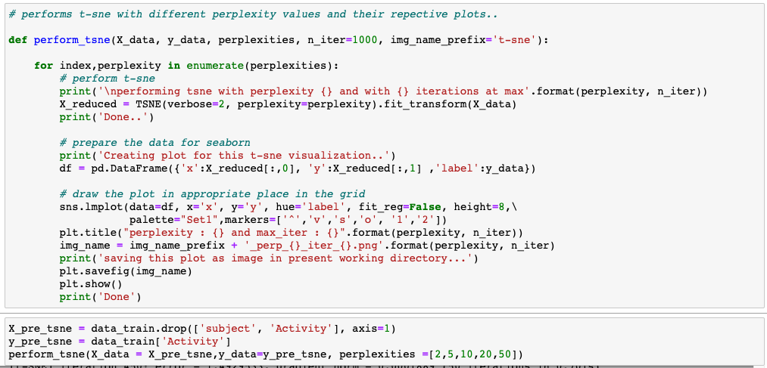
Static : Sitting, Standing, Laying
Dynamic : Walking, Walking Upstairs, Walking downstairs
T-SNE
perplexity
Max_iter
EXPLORING
50
1000
DATA
All Activities can be cleanly separated except Standing and Sitting
Code

Slide 23
Principal Component Analysis
EXPLORING
y
Converting
high-dimensional data
To low dimensional
by selecting the most
Important features
DATA
x
Code

Slide 24
Principal Component Analysis
Converting
high-dimensional data
To low dimensional
by selecting the most
Important features
y
EXPLORING
x
PCA transformation
DATA
Code

Slide 25
Principal Component Analysis
Converting
high-dimensional data
To low dimensional
by selecting the most
Important features
y
EXPLORING
x
PCA transformation
DATA
Code

Slide 26
Principal Component Analysis
Converting
high-dimensional data
To low dimensional
by selecting the most
Important features
y
EXPLORING
x
PCA transformation
DATA
Code

Slide 27
Principal Component Analysis
Converting
high-dimensional data
To low dimensional
by selecting the most
Important features
y
EXPLORING
x
PCA transformation
DATA
Code

Slide 28
Principal Component Analysis
Converting
high-dimensional data
To low dimensional
by selecting the most
Important features
y
EXPLORING
x
PCA transformation
DATA
pc2
pc1
Code

Slide 29
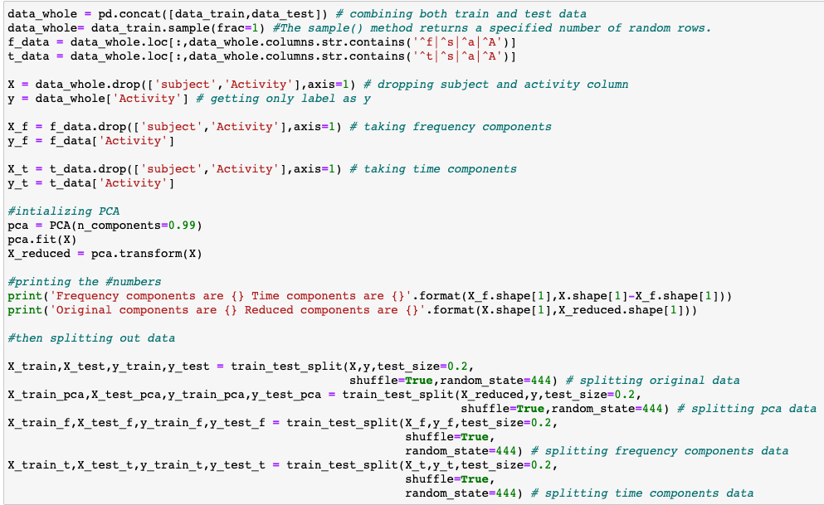
Principal Component Analysis
Converting
high-dimensional data
To low dimensional
by selecting the most
Important features
The features are selected on the basis of the variance that they cause in the output.
EXPLORING
Reduce the training time
DATA
It is always not possible to analyze data with high dimension
pc2
pc1
Code

Slide 30
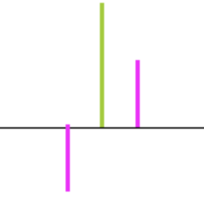
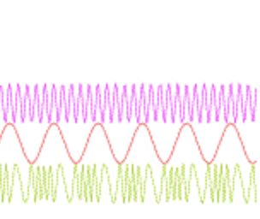
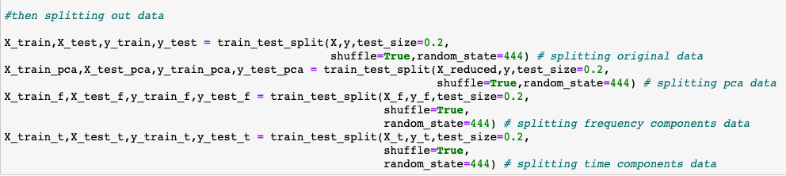
Data Domains Present
265 components
296 components
signal
signal
EXPLORING
DATA
time
frequency
Original Components : 561
Reduced Components : 155
tBodyAcc
tGravityAcc
tBodyAccJerk
tBodyGyro
tBodyGyroJerk
tBodyAccMag
tGravityAccMag
tBodyAccJerkMag
tBodyGyroMag
tBodyGyroJerkMag
Y
fBodyAcc
fBodyAccJerk
fBodyGyro
fBodyAccMag
fBodyAccJerkMag
fBodyGyroMag
fBodyGyroJerkMag
X
Prefix: f
{prefix : t
Z
Code

Slide 31
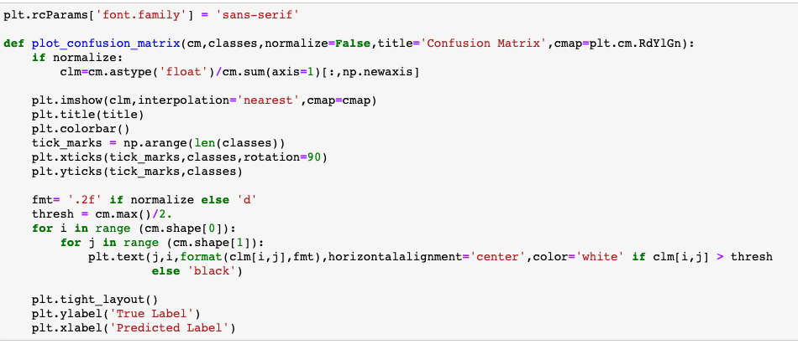
Static : Sitting, Standing, Laying
Dynamic : Walking, Walking Upstairs, Walking downstairs
} [Labels]
Creating Functions : Confusion Matrix
Confusion matrix is a table that is used to define the performance of a classification algorithm
Predicted Class
SUPERVISED
yes
no
True Positive
False Negative
False Positive
True Negative
LEARNING
yes
True Class
no
Code

Slide 32
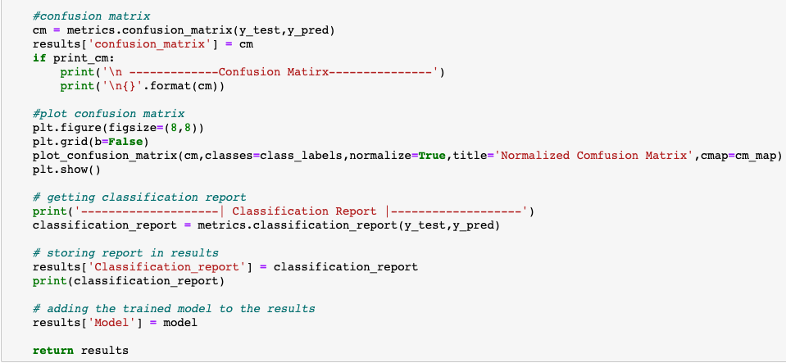
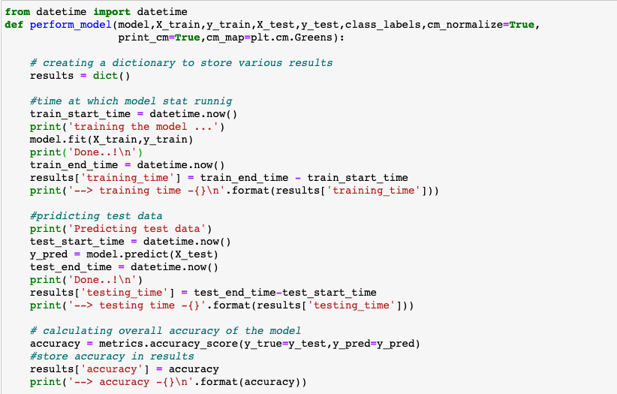
Static : Sitting, Standing, Laying
Dynamic : Walking, Walking Upstairs, Walking downstairs
} [Labels]
Creating Functions : Run Models
Classification Report with y_test & y_pred
Define function
SUPERVISED
Training model
Store results in results List object
With Argument:
Model
Train Data (X,y)
Test data (X,y)
Class Labels
Predicting data test
LEARNING
Calculating overall accuracy
Confusion Matrix
Plot confusion Matrix
Using fit method
Predict method on X_test
Classification Report
Store report
Accuracy score method
Confusion matrix with y_test & y_pred
C1
C2

Slide 33
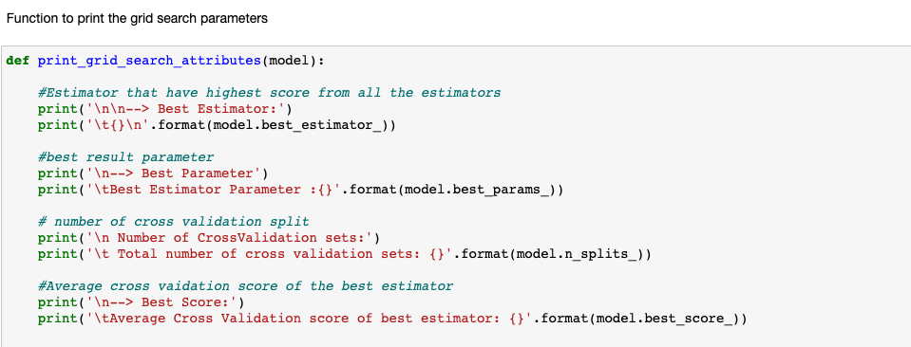
Static : Sitting, Standing, Laying
Dynamic : Walking, Walking Upstairs, Walking downstairs
} [Labels]
Creating Functions : Print GridSearch
Created Function to print the following:
SUPERVISED
Best Estimator. : best_estimator_
LEARNING
Best Parameter. : best_params_
Across GridSearchCV evaluation
Best Score : best_score_
Number of splits : n_splits_
Code

Slide 34
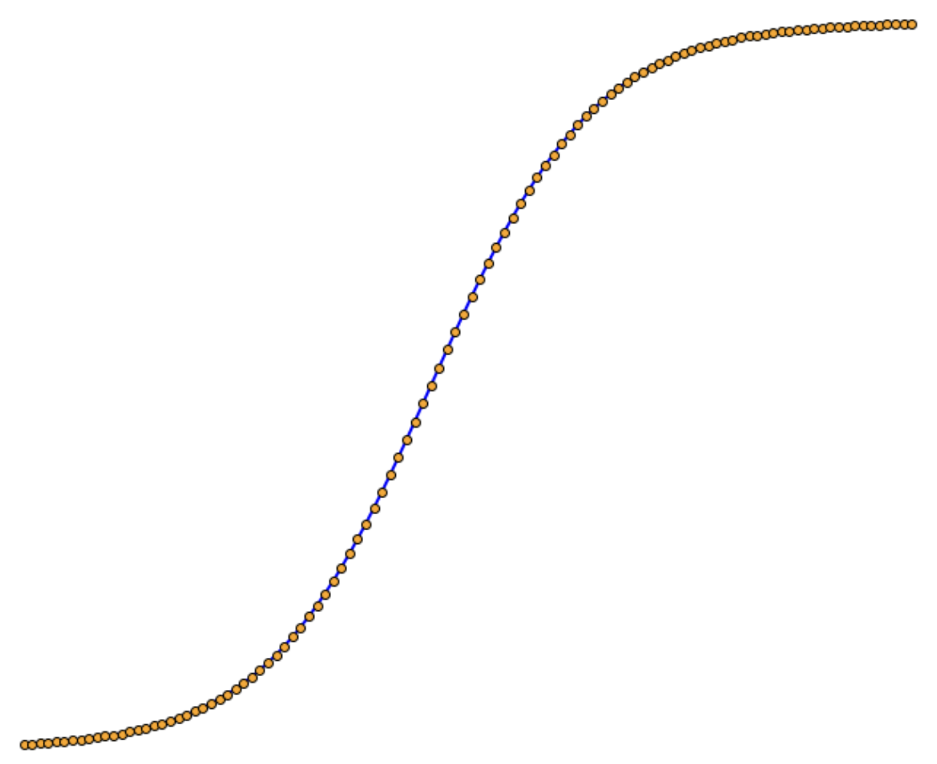
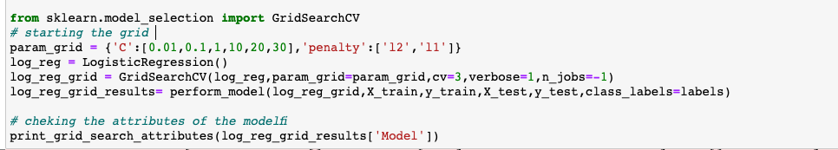
Static : Sitting, Standing, Laying
Dynamic : Walking, Walking Upstairs, Walking downstairs
} [Labels]
Modeling
Logistic Regression
y
0
1
2
3
4
5
1
0
1
2
3
4
5
SUPERVISED
0
1
2
3
4
5
0
1
2
3
4
5
0
1
2
3
4
5
0
1
2
3
4
5
0
1
2
3
4
5
.5
LEARNING
Labels
0
x
Code

Slide 35
Static : Sitting, Standing, Laying
Dynamic : Walking, Walking Upstairs, Walking downstairs
} [Labels]
Modeling
Logistic Regression
Parameter Grid
SUPERVISED
C
Inverse of regularization strength
0.01, 0.1, 1, 10, 20, 30
LEARNING
A high value of C tells the model to give high weight to training data, and lower weight to the complexity penalty
Penalty
l1, l2
L1 regularization penalize the sum of absolute values of weights
L2 regularization penalize the sum of squares of the weights.
1
2
3
train | train | validation
train | validation | train
validation | train | train
CV
3
Cross Validation
Code

Slide 36
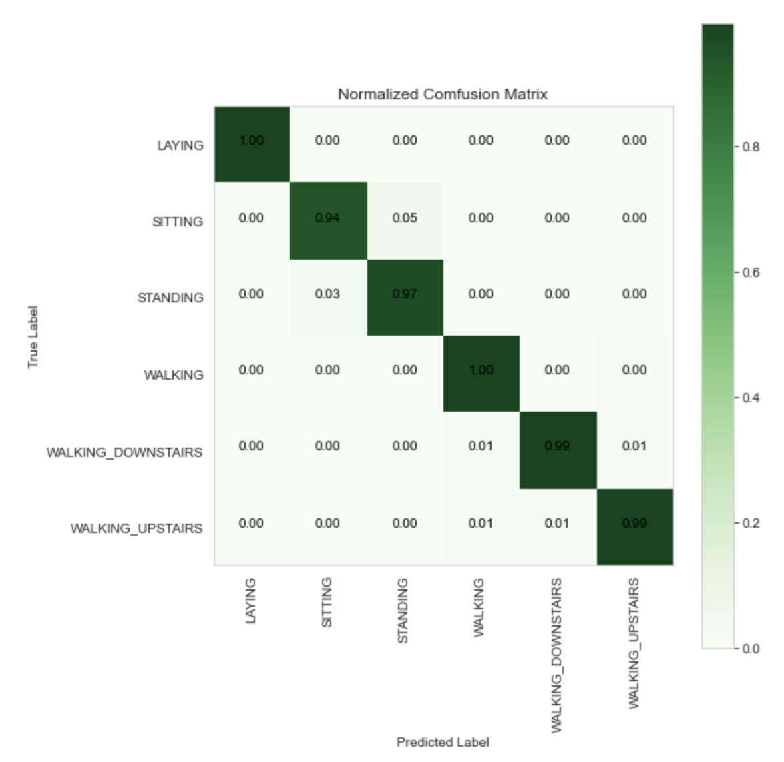
Static : Sitting, Standing, Laying
Dynamic : Walking, Walking Upstairs, Walking downstairs
} [Labels]
Modeling
Logistic Regression
Accuracy Score
97.98%
SUPERVISED
 | Laying | Sitting | Standing | Walking | Walking down | Walking Up
Laying | 304 | 0 | 0 | 0 | 0 | 1
Sitting | 1 | 252 | 14 | 0 | 0 | 1
Standing | 0 | 9 | 275 | 0 | 0 | 0
Walking | 0 | 0 | 0 | 217 | 0 | 1
Walking down | 0 | 0 | 0 | 1 | 197 | 1
Walking Up | 0 | 0 | 0 | 1 | 1 | 198
Classification Report
 | precision | recall | f1-score | support
Laying | 1.00 | 1.00 | 1.00 | 305
Sitting | 0.97 | 0.94 | 0.95 | 268
Standing | 0.95 | 0.97 | 0.96 | 284
Walking | 0.99 | 1.00 | 0.99 | 218
Walking down | 0.99 | 0.99 | 0.99 | 196
Walking UP | 0.98 | 0.99 | 0.99 | 200
Accuracy |  |  | 0.98 | 1471
Macro Avg | 0.98 | 0.98 | 0.98 | 1471
Weighted Avg | 0.98 | 0.98 | 0.98 | 1471
Confusion Matrix
LEARNING
Best Estimator
Logistic Regression(C=10)
Best Parameter
C:10, penalty”’l2’
Cross Validation sets
3
Avg cross validation score
Of best estimator
98.06%
Figure
Code

Slide 37
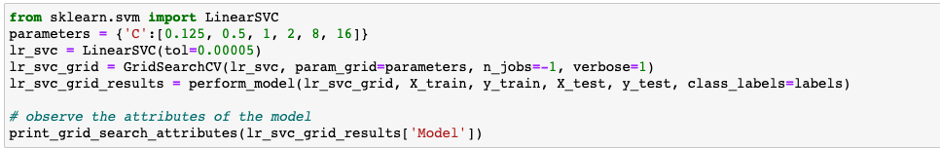
Static : Sitting, Standing, Laying
Dynamic : Walking, Walking Upstairs, Walking downstairs
} [Labels]
Modeling
Logistic
Regression
Linear SVC
Support Vector Classifier goal is to split or categorize our data into a ”best fit” hyperplane
SUPERVISED
LEARNING
y
y
x
x
Code

Slide 38
Static : Sitting, Standing, Laying
Dynamic : Walking, Walking Upstairs, Walking downstairs
} [Labels]
Modeling
Logistic
Regression
Linear SVC
Parameter Grid
SUPERVISED
C
Inverse of regularization strength
0.125, 0.5, 1, 2, 8, 16
LEARNING
tol
0.00005
Tolerance in optimization
Best
Parameter
Code

Slide 39
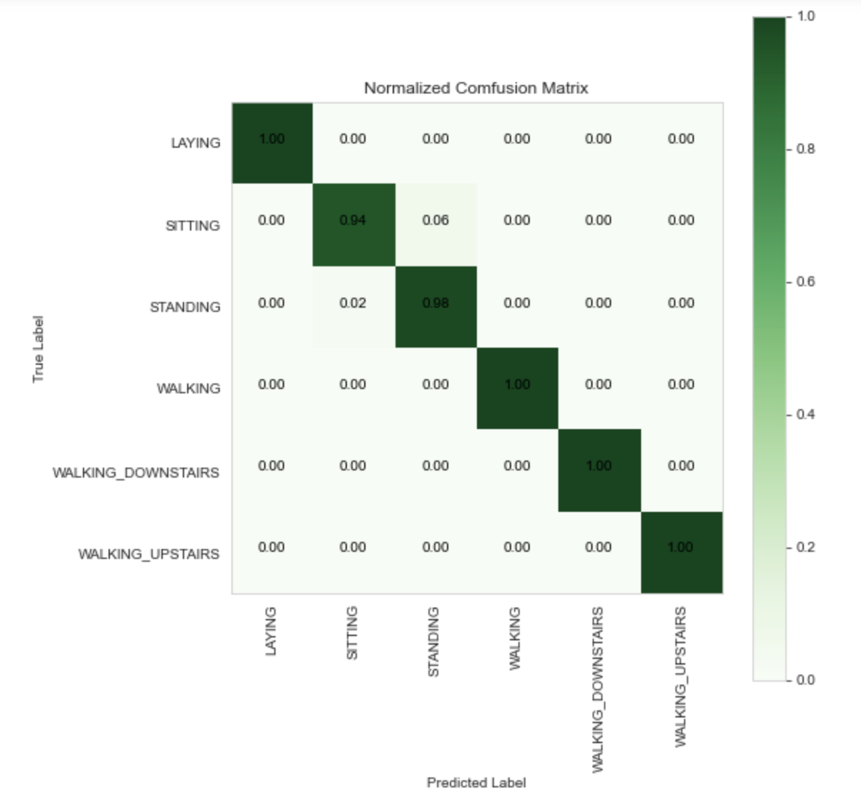
Static : Sitting, Standing, Laying
Dynamic : Walking, Walking Upstairs, Walking downstairs
} [Labels]
Modeling
Logistic
Regression
Linear SVC
Accuracy Score
98.57%
SUPERVISED
 | Laying | Sitting | Standing | Walking | Walking down | Walking Up
Laying | 305 | 0 | 0 | 0 | 0 | 0
Sitting | 0 | 253 | 15 | 0 | 0 | 0
Standing | 0 | 6 | 278 | 0 | 0 | 0
Walking | 0 | 0 | 0 | 218 | 0 | 0
Walking down | 0 | 0 | 0 | 0 | 196 | 0
Walking Up | 0 | 0 | 0 | 0 | 0 | 200
 | precision | recall | f1-score | support
Laying | 1.00 | 1.00 | 1.00 | 305
Sitting | 0.98 | 0.94 | 0.96 | 268
Standing | 0.95 | 0.98 | 0.96 | 284
Walking | 1.00 | 1.00 | 1.00 | 218
Walking down | 1.00 | 1.00 | 1.00 | 196
Walking UP | 1.00 | 1.00 | 1.00 | 200
Accuracy |  |  | 0.99 | 1471
Macro Avg | 0.99 | 0.99 | 0.99 | 1471
Weighted Avg | 0.99 | 0.99 | 0.99 | 1471
Classification Report
Confusion Matrix
LEARNING
Best Estimator
LinearSVC(C=1, tol=5e-05)
Best Parameter
'C': 1
Cross Validation sets
5
Avg crossvalidation score Of
best estimator
98.55%
Figure

Slide 40
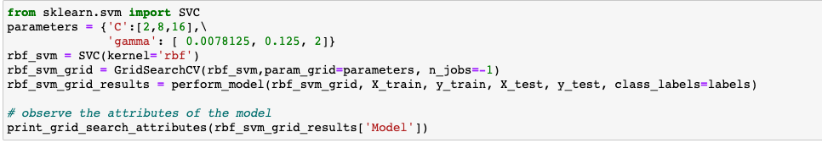
Static : Sitting, Standing, Laying
Dynamic : Walking, Walking Upstairs, Walking downstairs
} [Labels]
Modeling
Logistic
Regression
Linear
SVC
Kernel SVM
The function of the kernel is to take data as input and transform it into the required form.
SUPERVISED
LEARNING
y
y
Decision Surface
x
x
We are using radial basis function (rbf)
Code

Slide 41
Static : Sitting, Standing, Laying
Dynamic : Walking, Walking Upstairs, Walking downstairs
} [Labels]
Modeling
Logistic
Regression
Linear
SVC
Kernel SVM
Parameter Grid
SUPERVISED
C
Inverse of regularization strength
2, 8, 16
LEARNING
gamma
0.1, 0.125, 2
Defines how far the influence of
a single training example reaches
‘rbf’
kernal

Slide 42
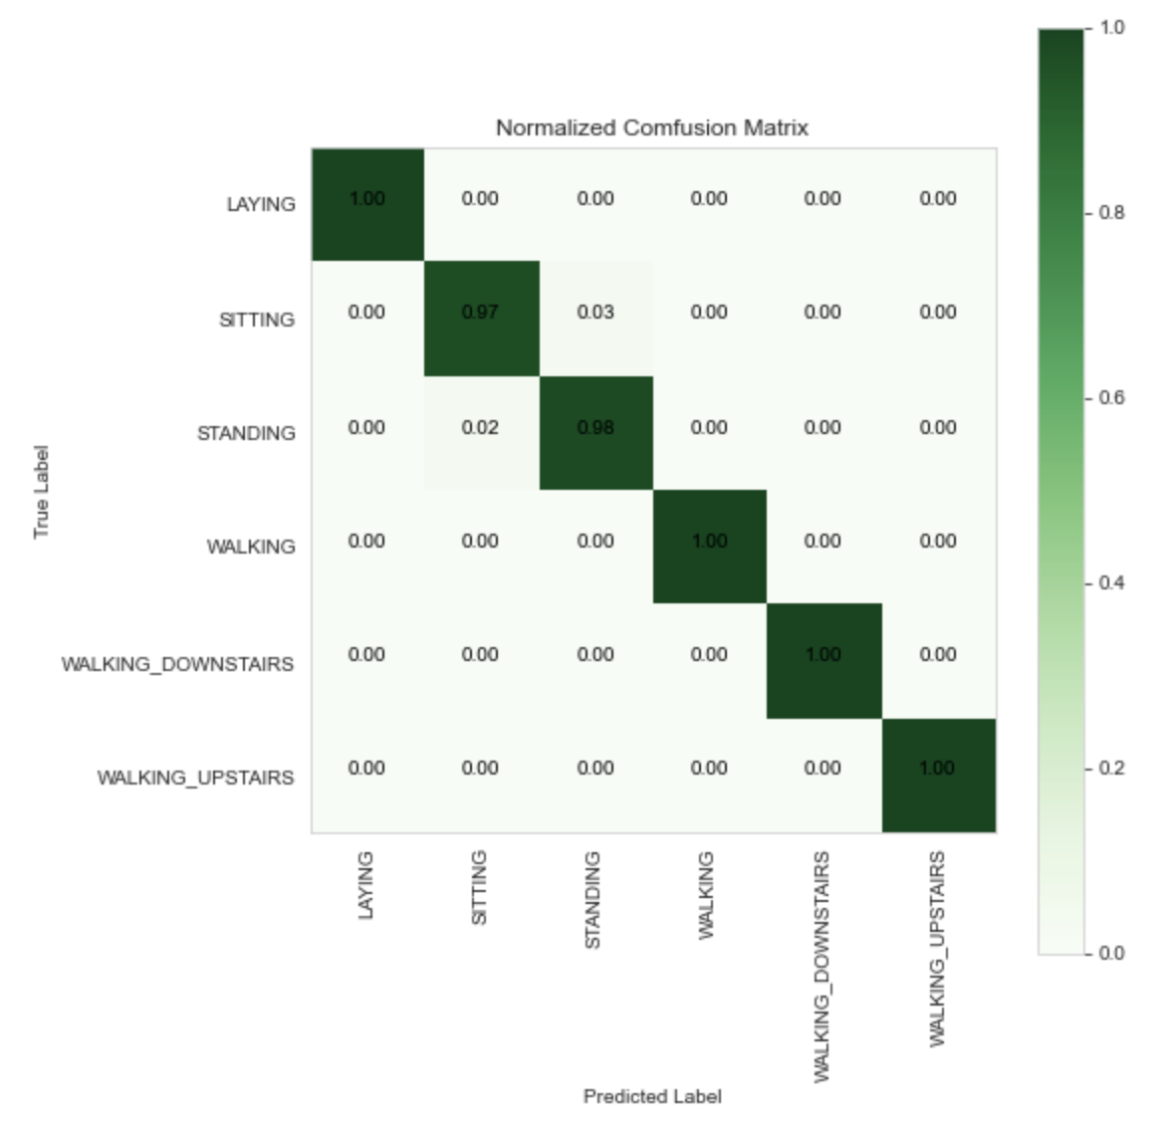
Static : Sitting, Standing, Laying
Dynamic : Walking, Walking Upstairs, Walking downstairs
} [Labels]
Modeling
Logistic
Regression
Linear
SVC
Kernel SVM
Accuracy Score
98.98%
SUPERVISED
 | Laying | Sitting | Standing | Walking | Walking down | Walking Up
Laying | 305 | 0 | 0 | 0 | 0 | 0
Sitting | 0 | 260 | 7 | 0 | 0 | 1
Standing | 0 | 7 | 277 | 0 | 0 | 0
Walking | 0 | 0 | 0 | 218 | 0 | 0
Walking down | 0 | 0 | 0 | 0 | 196 | 0
Walking Up | 0 | 0 | 0 | 0 | 0 | 200
 | precision | recall | f1-score | support
Laying | 1.00 | 1.00 | 1.00 | 305
Sitting | 0.97 | 0.97 | 0.97 | 268
Standing | 0.98 | 0.98 | 0.98 | 284
Walking | 1.00 | 1.00 | 1.00 | 218
Walking down | 1.00 | 1.00 | 1.00 | 196
Walking UP | 1.00 | 1.00 | 1.00 | 200
Accuracy |  |  | 0.99 | 1471
Macro Avg | 0.99 | 0.99 | 0.99 | 1471
Weighted Avg | 0.99 | 0.99 | 0.99 | 1471
Confusion Matrix
Classification Report
LEARNING
Best Estimator
SVC(C=16, gamma=0.1)
Best Parameter
'C': 16, 'gamma’: 0.1
Cross Validation sets
5
Avg crossvalidation score Of
best estimator
98.70%
Figure

Slide 43
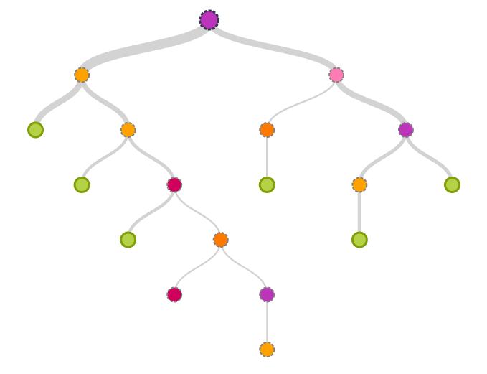
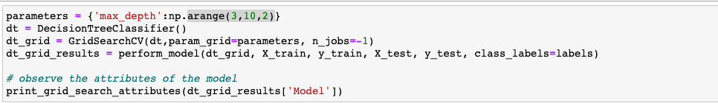
Static : Sitting, Standing, Laying
Dynamic : Walking, Walking Upstairs, Walking downstairs
} [Labels]
Modeling
Logistic
Regression
Linear
SVC
Kernel
SVM
Decision Tree
Parameter Grid
IF
GravityX Mean >0.2
SUPERVISED
yes
no
max_depth
3,5,7,9
Determine the maximum depth of tree
yes
no
yes
no
LEARNING
yes
no
yes
no
yes
no
yes
no
Figure
Code

Slide 44
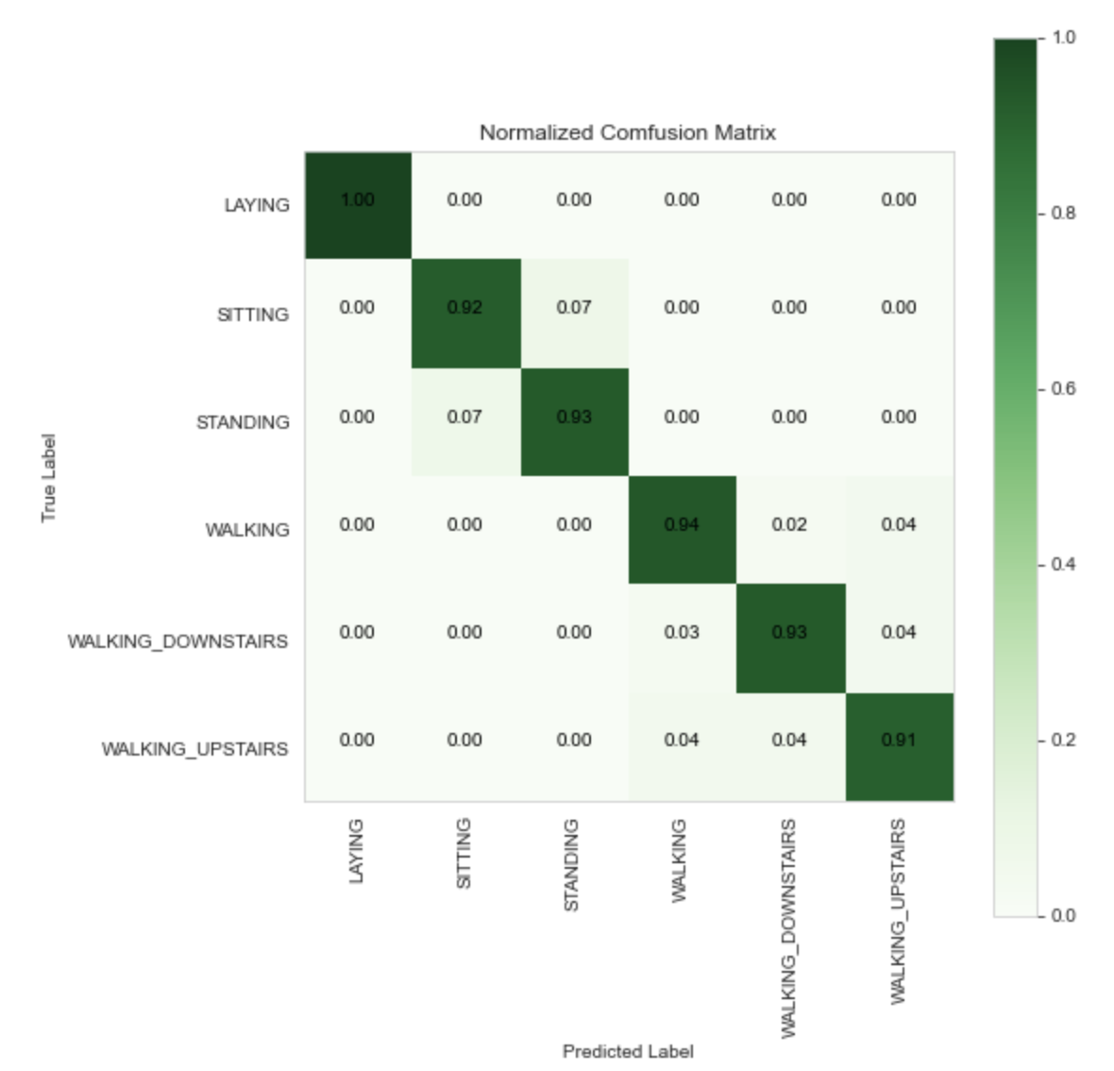
Static : Sitting, Standing, Laying
Dynamic : Walking, Walking Upstairs, Walking downstairs
} [Labels]
Modeling
Logistic
Regression
Linear
SVC
Kernel
SVM
Decision Tree
Accuracy Score
94.01%
SUPERVISED
Classification Report
Confusion Matrix
 | Laying | Sitting | Standing | Walking | Walking down | Walking Up
Laying | 305 | 0 | 0 | 0 | 0 | 0
Sitting | 0 | 247 | 20 | 1 | 0 | 1
Standing | 0 | 21 | 263 | 0 | 0 | 0
Walking | 0 | 0 | 0 | 204 | 5 | 9
Walking down | 0 | 0 | 0 | 6 | 182 | 8
Walking Up | 0 | 0 | 0 | 9 | 9 | 182
 | precision | recall | f1-score | support
Laying | 1.00 | 1.00 | 1.00 | 305
Sitting | 0.92 | 0.92 | 0.92 | 268
Standing | 0.93 | 0.93 | 0.93 | 284
Walking | 0.93 | 0.94 | 0.93 | 218
Walking down | 0.93 | 0.93 | 0.93 | 196
Walking UP | 0.91 | 0.91 | 0.91 | 200
Accuracy |  |  | 0.94 | 1471
Macro Avg | 0.94 | 0.94 | 0.94 | 1471
Weighted Avg | 0.94 | 0.94 | 0.94 | 1471
LEARNING
Best Estimator
DecisionTreeClassifier(max_depth=9)
Best Parameter
'max_depth': 9
Cross Validation sets
5
Avg crossvalidation score Of
best estimator
94.20%
Figure

Slide 45
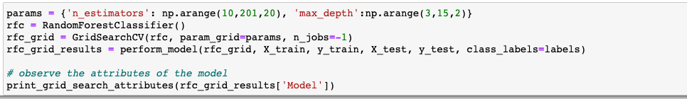
Static : Sitting, Standing, Laying
Dynamic : Walking, Walking Upstairs, Walking downstairs
} [Labels]
Modeling
Logistic
Regression
Linear
SVC
Kernel
SVM
Decision
Tree
Random Forest
Classifier
Random forest operates by constructing multitude of decision trees at training time
Training sample set X
SUPERVISED
X1
X1
X1
LEARNING
class1
class2
class3
Voting
Results
Code

Slide 46
Static : Sitting, Standing, Laying
Dynamic : Walking, Walking Upstairs, Walking downstairs
} [Labels]
Modeling
Logistic
Regression
Linear
SVC
Kernel
SVM
Decision
Tree
Random Forest
Classifier
SUPERVISED
Parameter Grid
LEARNING
Max_depth
Determine the maximum depth of tree
3, ,5, 7, ……. 13, 15
N Estimators
10, 30, 50, ……..170, 190
the number of trees you want to build before
taking the maximum voting or averages of predictions

Slide 47
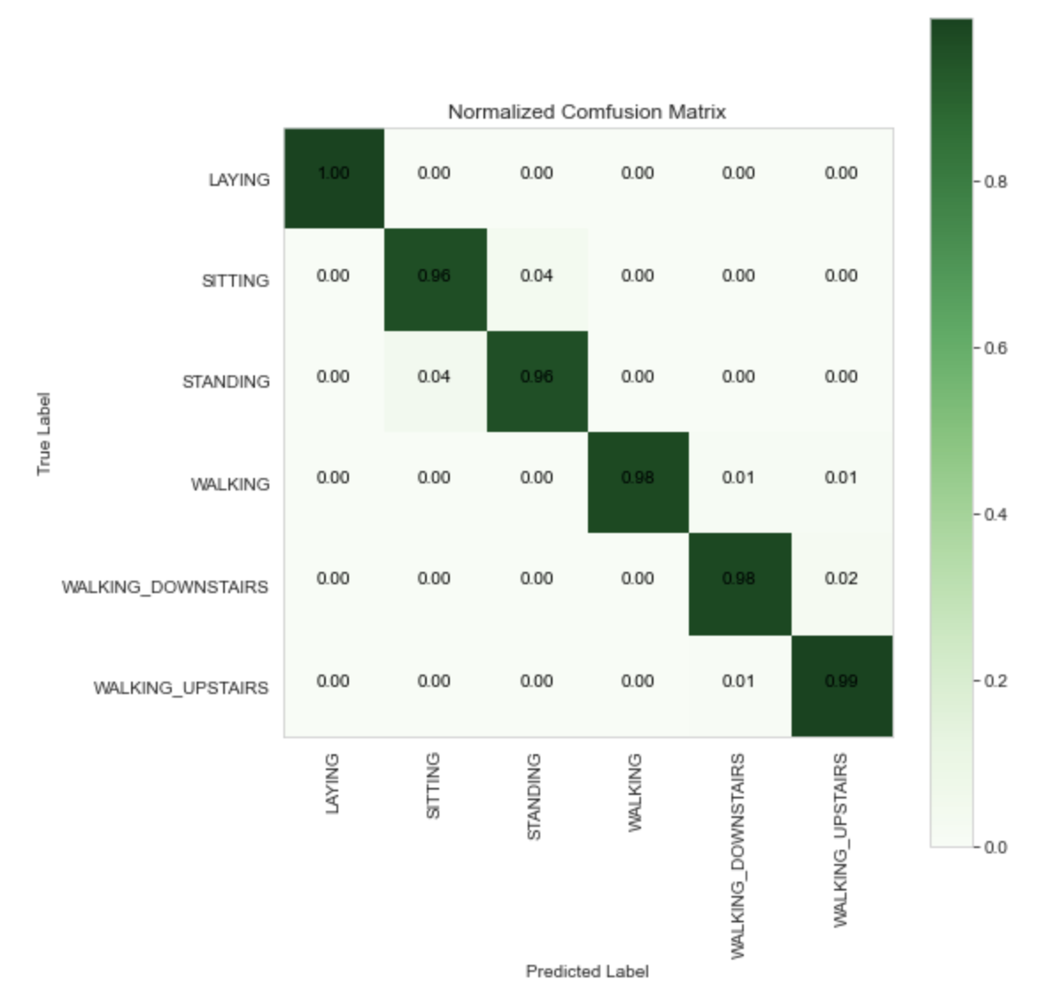
Static : Sitting, Standing, Laying
Dynamic : Walking, Walking Upstairs, Walking downstairs
} [Labels]
Modeling
Logistic
Regression
Linear
SVC
Kernel
SVM
Decision
Tree
Random Forest
Classifier
Accuracy Score
97.68%
SUPERVISED
 | precision | recall | f1-score | support
Laying | 1.00 | 1.00 | 1.00 | 305
Sitting | 0.96 | 0.96 | 0.96 | 268
Standing | 0.96 | 0.96 | 0.96 | 284
Walking | 1.00 | 0.98 | 0.99 | 218
Walking down | 0.98 | 0.98 | 0.98 | 196
Walking UP | 0.96 | 0.99 | 0.98 | 200
Accuracy |  |  | 0.98 | 1471
Macro Avg | 0.98 | 0.98 | 0.98 | 1471
Weighted Avg | 0.98 | 0.98 | 0.98 | 1471
Confusion Matrix
Classification Report
 | Laying | Sitting | Standing | Walking | Walking down | Walking Up
Laying | 304 | 0 | 0 | 0 | 0 | 1
Sitting | 0 | 257 | 10 | 1 | 0 | 1
Standing | 0 | 12 | 272 | 0 | 0 | 0
Walking | 0 | 0 | 0 | 213 | 2 | 3
Walking down | 0 | 0 | 0 | 0 | 192 | 4
Walking Up | 0 | 0 | 0 | 0 | 1 | 199
LEARNING
RandomForestClassifier
(max_depth=13, n_estimators=150)
Best Estimator
Best Parameter
'max_depth': 13, 'n_estimators': 150
Cross Validation sets
5
Avg crossvalidation score Of
best estimator
97.87%
Figure

Slide 48
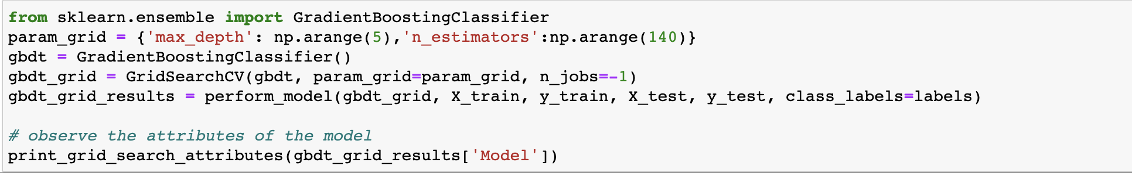
Static : Sitting, Standing, Laying
Dynamic : Walking, Walking Upstairs, Walking downstairs
} [Labels]
Modeling
Logistic
Regression
Linear
SVC
Kernel
SVM
Decision
Tree
Random Forest
Classifier
Gradient Boosted
group of machine learning algorithms that combine many weak l
earning models together to create a strong predictive model.
SUPERVISED
…….
LEARNING
train
train
train
tree1
Tree 2
Tree n
w1
w2
wn
Ensemble Prediction
Code

Slide 49
Static : Sitting, Standing, Laying
Dynamic : Walking, Walking Upstairs, Walking downstairs
} [Labels]
Modeling
Logistic
Regression
Linear
SVC
Kernel
SVM
Decision
Tree
Random Forest
Classifier
Gradient Boosted
SUPERVISED
Parameter Grid
LEARNING
Max_depth
Determine the maximum depth of tree
1, 2, 3, 4, 5
N Estimators
np.arange(140)
the number of trees you want to build before
taking the maximum voting or averages of predictions
Figure

Slide 50
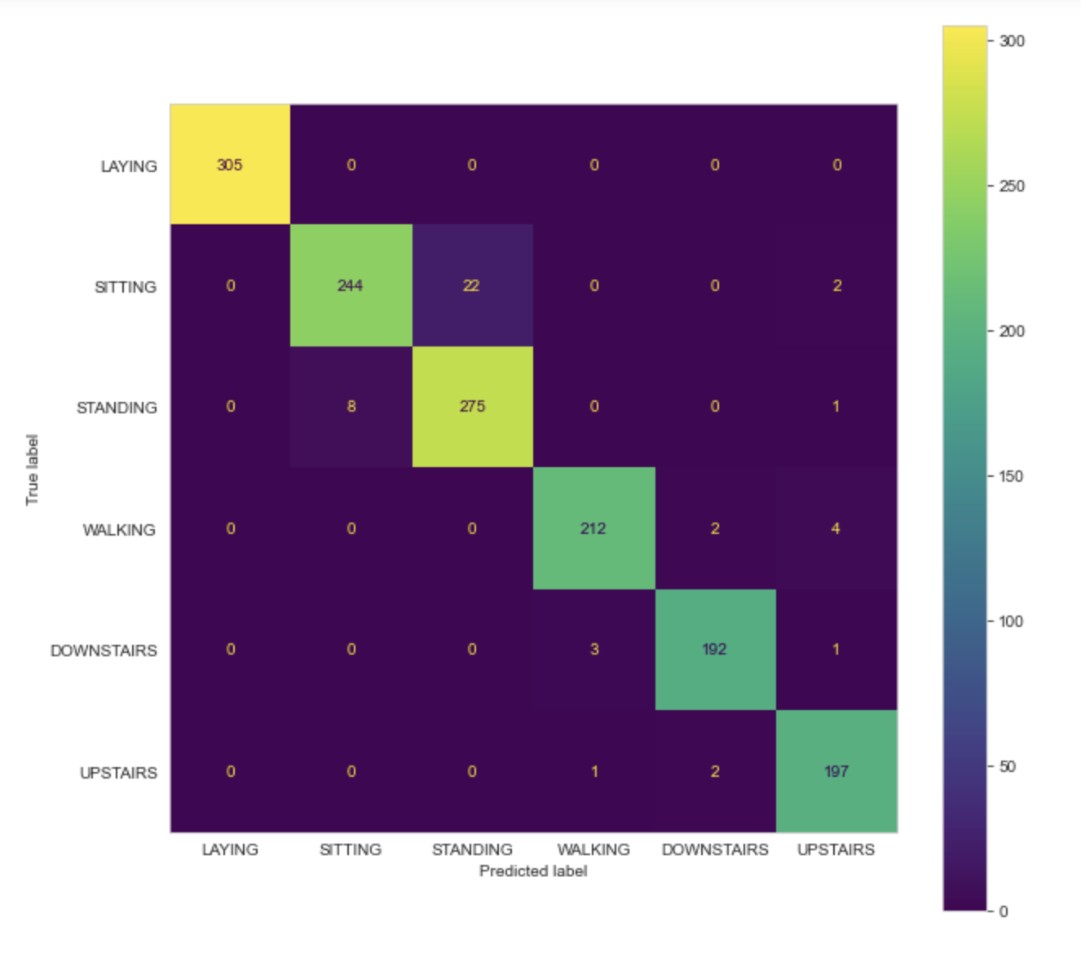
Static : Sitting, Standing, Laying
Dynamic : Walking, Walking Upstairs, Walking downstairs
} [Labels]
Modeling
Logistic
Regression
Linear
SVC
Kernel
SVM
Decision
Tree
Random Forest
Classifier
Gradient Boosted
Accuracy Score
96.87%
SUPERVISED
Confusion Matrix
 | precision | recall | f1-score | support
Laying | 1.00 | 1.00 | 1.00 | 305
Sitting | 0.96 | 0.96 | 0.96 | 268
Standing | 0.96 | 0.96 | 0.96 | 284
Walking | 1.00 | 0.98 | 0.99 | 218
Walking down | 0.98 | 0.98 | 0.98 | 196
Walking UP | 0.96 | 0.99 | 0.98 | 200
Accuracy |  |  | 0.98 | 1471
Macro Avg | 0.98 | 0.98 | 0.98 | 1471
Weighted Avg | 0.98 | 0.98 | 0.98 | 1471
Classification Report
 | Laying | Sitting | Standing | Walking | Walking down | Walking Up
Laying | 305 | 0 | 0 | 0 | 0 | 0
Sitting | 0 | 244 | 22 | 1 | 0 | 2
Standing | 0 | 8 | 275 | 0 | 0 | 0
Walking | 0 | 0 | 0 | 212 | 2 | 4
Walking down | 0 | 0 | 0 | 3 | 192 | 1
Walking Up | 0 | 0 | 0 | 1 | 2 | 197
LEARNING
XGBClassifier
(max_depth=5, n_estimators=100)
Best Estimator
Best Parameter
'max_depth’: 5, 'n_estimators’: 100
Cross Validation sets
5
Avg crossvalidation score Of
best estimator
96.87%
Figure

Slide 51
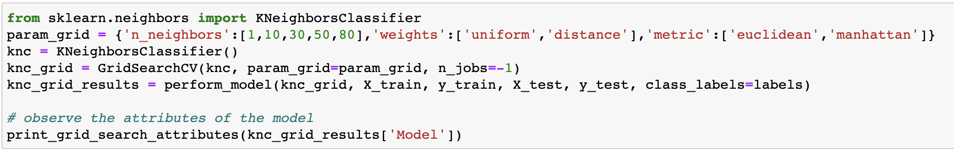
Static : Sitting, Standing, Laying
Dynamic : Walking, Walking Upstairs, Walking downstairs
} [Labels]
Modeling
Logistic
Regression
Linear
SVC
Kernel
SVM
Decision
Tree
Random Forest
Classifier
Gradient
Boosted
K-nearest
Neighbor
Uses closeness to produce classifications or predictions about groups of individual datapoints
SUPERVISED
A
A
LEARNING
y
y
New data point
Assigned do B
New data point
B
B
x
x
Code

Slide 52
Static : Sitting, Standing, Laying
Dynamic : Walking, Walking Upstairs, Walking downstairs
} [Labels]
Modeling
Logistic
Regression
Linear
SVC
Kernel
SVM
Decision
Tree
Random Forest
Classifier
Gradient
Boosted
K-nearest
Neighbor
SUPERVISED
Parameter Grid
LEARNING
N Neighbors
Number of nearest neighbors
1, 10, 30, 50, 80
Weights
Uniform, distance
signifies how weight should be distributed
between neighbor values
metric
Euclidean, Manhattan
How distance is calculated
Figure

Slide 53

Static : Sitting, Standing, Laying
Dynamic : Walking, Walking Upstairs, Walking downstairs
} [Labels]
Modeling
Logistic
Regression
Linear
SVC
Kernel
SVM
Decision
Tree
Random Forest
Classifier
Gradient
Boosted
K-nearest
Neighbor
Accuracy Score
98.30%
SUPERVISED
Classification Report
Confusion Matrix
 | precision | recall | f1-score | support
Laying | 1.00 | 1.00 | 1.00 | 305
Sitting | 0.96 | 0.95 | 0.95 | 268
Standing | 0.95 | 0.96 | 0.96 | 284
Walking | 1.00 | 1.00 | 1.00 | 218
Walking down | 1.00 | 1.00 | 1.00 | 196
Walking UP | 1.00 | 1.00 | 1.00 | 200
Accuracy |  |  | 0.98 | 1471
Macro Avg | 0.98 | 0.98 | 0.98 | 1471
Weighted Avg | 0.98 | 0.98 | 0.98 | 1471
 | Laying | Sitting | Standing | Walking | Walking down | Walking Up
Laying | 305 | 0 | 0 | 0 | 0 | 0
Sitting | 0 | 254 | 13 | 0 | 0 | 1
Standing | 0 | 11 | 274 | 0 | 0 | 0
Walking | 0 | 0 | 0 | 218 | 0 | 0
Walking down | 0 | 0 | 0 | 0 | 196 | 0
Walking Up | 0 | 0 | 0 | 0 | 0 | 200
LEARNING
KNeighborsClassifier
(metric='manhattan', n_neighbors=1)
Best Estimator
Best Parameter
'metric': 'manhattan', 'n_neighbors': 1,
'weights': 'uniform'
Cross Validation sets
5
Avg crossvalidation score Of
best estimator
98.11%
Figure

Slide 54
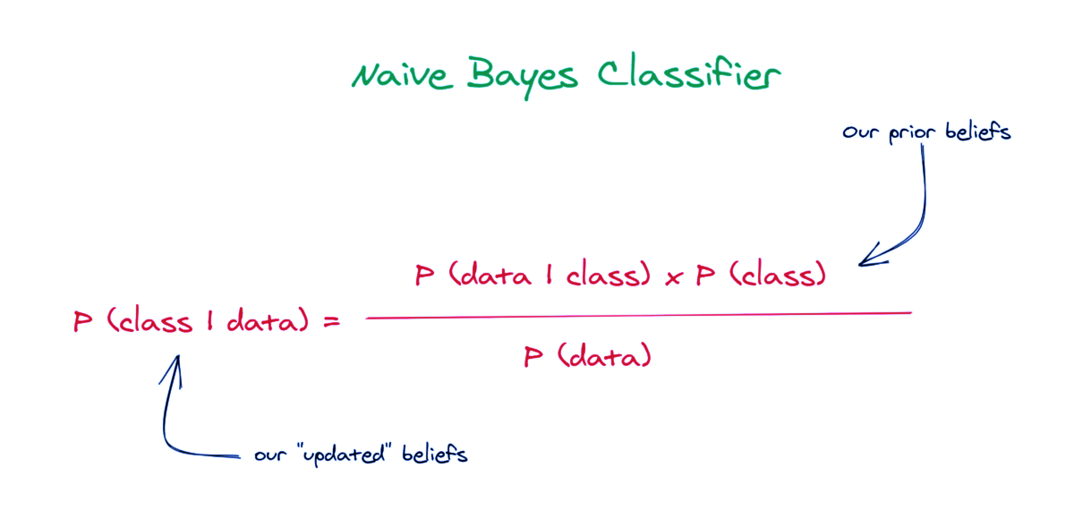
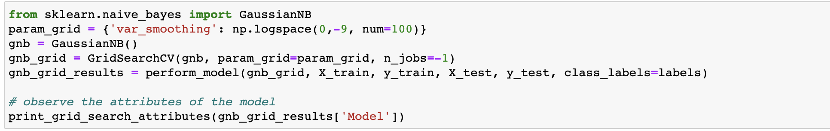
Static : Sitting, Standing, Laying
Dynamic : Walking, Walking Upstairs, Walking downstairs
} [Labels]
Modeling
Logistic
Regression
Linear
SVC
Kernel
SVM
Decision
Tree
Random Forest
Classifier
Gradient
Boosted
K-nearest
Neighbor
Naïve Bayes
Naive Bayes classifier assumes that the effect of a particular
feature in a class is independent of other features
SUPERVISED
LEARNING
Code

Slide 55
Static : Sitting, Standing, Laying
Dynamic : Walking, Walking Upstairs, Walking downstairs
} [Labels]
Modeling
Logistic
Regression
Linear
SVC
Kernel
SVM
Decision
Tree
Random Forest
Classifier
Gradient
Boosted
Random Forest
Classifier
K-nearest
Neighbor
Naïve Bayes
SUPERVISED
Parameter Grid
LEARNING
Var Smoothing
Helps tackle the problem of zero
probability in the Naïve Bayes
0.24, 0.65, 0.89, 0.127
Figure

Slide 56
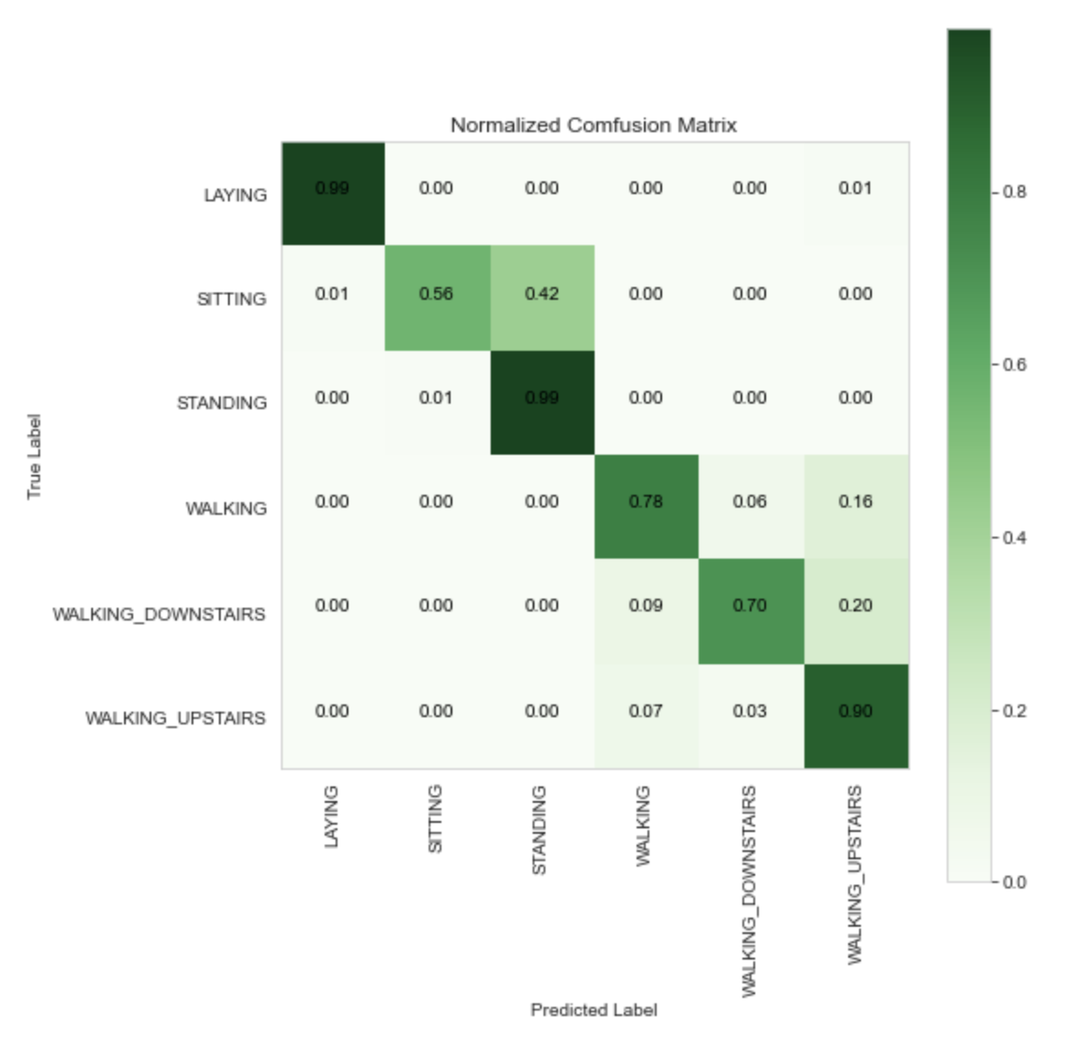
Static : Sitting, Standing, Laying
Dynamic : Walking, Walking Upstairs, Walking downstairs
} [Labels]
Modeling
Logistic
Regression
Linear
SVC
Kernel
SVM
Decision
Tree
Random Forest
Classifier
Gradient
Boosted
K-nearest
Neighbor
Naïve Bayes
Accuracy Score
83.00%
SUPERVISED
 | precision | recall | f1-score | support
Laying | 0.99 | 0.99 | 0.99 | 305
Sitting | 0.99 | 0.56 | 0.72 | 268
Standing | 0.72 | 0.99 | 0.83 | 284
Walking | 0.84 | 0.78 | 0.81 | 218
Walking down | 0.88 | 0.70 | 0.78 | 196
Walking UP | 0.69 | 0.90 | 0.78 | 200
Accuracy |  |  | 0.83 | 1471
Macro Avg | 0.86 | 0.82 | 0.82 | 1471
Weighted Avg | 0.85 | 0.83 | 0.83 | 1471
Classification Report
 | Laying | Sitting | Standing | Walking | Walking down | Walking Up
Laying | 301 | 0 | 0 | 0 | 0 | 0
Sitting | 4 | 151 | 112 | 0 | 0 | 1
Standing | 0 | 2 | 281 | 0 | 0 | 0
Walking | 0 | 0 | 0 | 170 | 13 | 35
Walking down | 0 | 0 | 0 | 18 | 138 | 40
Walking Up | 0 | 0 | 0 | 14 | 6 | 180
Confusion Matrix
LEARNING
GaussianNB
(var_smoothing=0.0657933224657568)
Best Estimator
Best Parameter
'var_smoothing': 0.0657933224657568
Cross Validation sets
5
Avg crossvalidation score Of
best estimator
82.94%
Figure

Slide 57
Static : Sitting, Standing, Laying
Dynamic : Walking, Walking Upstairs, Walking downstairs
} [Labels]
Modeling
Scores
Accuracy
Error
SUPERVISED
Logistic
Regression
97.89%
2.10%
Linear
SVC
98.57%
1.42%
LEARNING
Kernel
SVM
98.48%
1.52%
Decision
Tree
94.02%
5.98%
Random Forest
Classifier
97.69%
2.31%
Gradient
Boosted
96.87%
3.13%
K-nearest
Neighbor
98.03%
1.7%
Naïve
Bayes
83.00%
17%

Slide 58
Static : Sitting, Standing, Laying
Dynamic : Walking, Walking Upstairs, Walking downstairs
} [Labels]
Modeling
Linear
SVC
SUPERVISED
Parameter Grid
LEARNING
C
Inverse of regularization strength
0.125, 0.5, 1, 2, 8, 16
tol
0.00005
Tolerance in optimization

Slide 59

Static : Sitting, Standing, Laying
Dynamic : Walking, Walking Upstairs, Walking downstairs
} [Labels]
Modeling
Linear
SVC
With
PCA
With Principal Components
Accuracy Score
98.09%
SUPERVISED
 | precision | recall | f1-score | support
Laying | 1.00 | 1.00 | 1.00 | 305
Sitting | 0.97 | 0.94 | 0.95 | 268
Standing | 0.94 | 0.97 | 0.95 | 284
Walking | 0.99 | 1.00 | 1.00 | 218
Walking down | 1.00 | 0.99 | 1.00 | 196
Walking UP | 1.00 | 0.99 | 1.00 | 200
Accuracy |  |  | 0.98 | 1471
Macro Avg | 0.98 | 0.98 | 0.98 | 1471
Weighted Avg | 0.98 | 0.98 | 0.98 | 1471
Classification Report
Confusion Matrix
 | Laying | Sitting | Standing | Walking | Walking down | Walking Up
Laying | 305 | 0 | 0 | 0 | 0 | 0
Sitting | 0 | 251 | 17 | 0 | 0 | 0
Standing | 0 | 9 | 275 | 0 | 0 | 0
Walking | 0 | 0 | 0 | 218 | 0 | 0
Walking down | 0 | 0 | 0 | 1 | 195 | 0
Walking Up | 0 | 0 | 0 | 1 | 0 | 199
LEARNING
Best Estimator
LinearSVC(C=2, tol=5e-05)
Best Parameter
'C’: 2
Cross Validation sets
5
Avg crossvalidation score Of
best estimator
98.41%
Figure

Slide 60

Static : Sitting, Standing, Laying
Dynamic : Walking, Walking Upstairs, Walking downstairs
} [Labels]
Modeling
Linear
SVC
With
PCA
Frequency domain data
Accuracy Score
96.05%
SUPERVISED
 | precision | recall | f1-score | support
Laying | 0.99 | 1.00 | 0.99 | 305
Sitting | 0.96 | 0.85 | 0.90 | 268
Standing | 0.89 | 0.96 | 0.92 | 284
Walking | 0.98 | 0.99 | 0.98 | 218
Walking down | 0.99 | 0.99 | 0.99 | 196
Walking UP | 0.98 | 0.98 | 0.98 | 200
Accuracy |  |  | 0.96 | 1471
Macro Avg | 0.96 | 0.96 | 0.96 | 1471
Weighted Avg | 0.96 | 0.96 | 0.96 | 1471
Confusion Matrix
 | Laying | Sitting | Standing | Walking | Walking down | Walking Up
Laying | 305 | 0 | 0 | 0 | 0 | 0
Sitting | 4 | 228 | 35 | 0 | 0 | 1
Standing | 0 | 10 | 274 | 0 | 0 | 0
Walking | 0 | 0 | 0 | 215 | 0 | 3
Walking down | 0 | 0 | 0 | 1 | 195 | 0
Walking Up | 0 | 0 | 0 | 3 | 0 | 196
Classification Report
LEARNING
Best Estimator
LinearSVC(C=8, tol=5e-05)
Best Parameter
'C’: 8
Cross Validation sets
5
Avg crossvalidation score Of
best estimator
96.92%
Figure

Slide 61

Static : Sitting, Standing, Laying
Dynamic : Walking, Walking Upstairs, Walking downstairs
} [Labels]
Modeling
Linear
SVC
With
PCA
Time domain data
Accuracy Score
98.70%
SUPERVISED
 | precision | recall | f1-score | support
Laying | 1.00 | 1.00 | 1.00 | 305
Sitting | 0.98 | 0.95 | 0.96 | 268
Standing | 0.96 | 0.98 | 0.97 | 284
Walking | 1.00 | 1.00 | 1.00 | 218
Walking down | 1.00 | 1.00 | 1.00 | 196
Walking UP | 1.00 | 1.00 | 1.00 | 200
Accuracy |  |  | 0.99 | 1471
Macro Avg | 0.99 | 0.99 | 0.99 | 1471
Weighted Avg | 0.99 | 0.99 | 0.99 | 1471
 | Laying | Sitting | Standing | Walking | Walking down | Walking Up
Laying | 305 | 0 | 0 | 0 | 0 | 0
Sitting | 0 | 255 | 13 | 0 | 0 | 0
Standing | 0 | 6 | 278 | 0 | 0 | 0
Walking | 0 | 0 | 0 | 218 | 0 | 3
Walking down | 0 | 0 | 0 | 0 | 196 | 0
Walking Up | 0 | 0 | 0 | 0 | 0 | 200
Classification Report
Confusion Matrix
LEARNING
Best Estimator
LinearSVC(C=0.5, tol=5e-05)
Best Parameter
'C’: 0.5
Cross Validation sets
5
Avg crossvalidation score Of
best estimator
98.65%
Figure

Slide 62
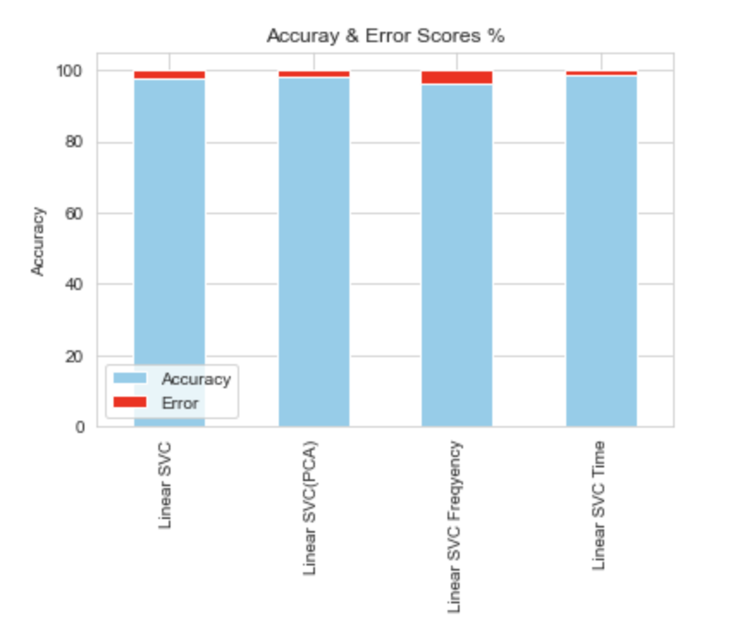
Static : Sitting, Standing, Laying
Dynamic : Walking, Walking Upstairs, Walking downstairs
} [Labels]
Modeling
We can use Linear SVC on whole data
Or only on
time domain subset data
on new data points to predict precise human activity.
SUPERVISED
LEARNING

Slide 63



Static : Sitting, Standing, Laying
Dynamic : Walking, Walking Upstairs, Walking downstairs
} [Labels]
Scaling Data
Standardizing the features by removing the mean
and scales each feature to unit variance
UNSUPERVISED
LEARNING
-20
0
20
-5
0
5
Code

Slide 64

Static : Sitting, Standing, Laying
Dynamic : Walking, Walking Upstairs, Walking downstairs
} [Labels]
Modeling
K-Means
Tries to group similar kinds of items in form of clusters
UNSUPERVISED
LEARNING
y
y
x
x
Code

Slide 65



Static : Sitting, Standing, Laying
Dynamic : Walking, Walking Upstairs, Walking downstairs
} [Labels]
Modeling
K-Means
Checking for best number of clusters using Elbow-Method
UNSUPERVISED
we will run the algorithm with 2 clusters
i.e.
n_cluster =2
The point after the inertia
decreases much slower after 2
LEARNING
Code

Slide 66



Static : Sitting, Standing, Laying
Dynamic : Walking, Walking Upstairs, Walking downstairs
} [Labels]
Modeling
K-Means
Fit the train data to KMeans Algorithm with
n_clusters – 2
algorithm – ‘elkan’
We can see the data using a scatter plot with gravity mean feature
UNSUPERVISED
LEARNING
Code

Slide 67
Static : Sitting, Standing, Laying
Dynamic : Walking, Walking Upstairs, Walking downstairs
} [Labels]
Modeling
K-Means
We can see the data using a scatter plot with gravity mean feature
Static activities
Dynamic activities
I believe that selecting 2 as the value for k will divide the data into two clusters:
UNSUPERVISED
LEARNING
Code

Slide 68

Modeling
K-Means
Performance evaluation
Changing labels to only 2 classes static : 0 and dynamic: 1 to check the performance.
UNSUPERVISED
Static : Sitting, Standing, Laying.
Dynamic : Walking, Walking Upstairs, Walking downstairs
0
LEARNING
1
Train Data
Test Data
Performance Score : 99.72%
Performance Score : 99.56%
Both performances on train and test have almost similar values
Code

Slide 69


Static : Sitting, Standing, Laying.
Dynamic : Walking, Walking Upstairs, Walking downstairs
} [Labels]
Modeling
K-Means
clustering the data points in the exact number of clusters
that exists in our dataset, n_cluster =6
UNSUPERVISED
Looks difficult to
Categorize them
Using 6 clusters
LEARNING
Code

Slide 70

Modeling
K-Means
Changing labels encoding
Static
Sitting
Standing
Laying.
UNSUPERVISED
0
1
2
3
4
5
LEARNING
Dynamic
Walking
Walking Upstairs
Walking downstairs
Code

Slide 71
Static : Sitting, Standing, Laying.
Dynamic : Walking, Walking Upstairs, Walking downstairs
} [Labels]
Modeling
K-Means
Performance evaluation
UNSUPERVISED
Train Data
Test Data
LEARNING
Performance Score : 53.07%
Performance Score : 56.97%
Decent Score!
Code

Slide 72
Static : Sitting, Standing, Laying.
Dynamic : Walking, Walking Upstairs, Walking downstairs
} [Labels]
Modeling
K-Means
Hyperparameter Tuning
UNSUPERVISED
Parameter grid
LEARNING
init
'k-means++'
'random'
selects initial cluster centroids
using sampling based
on an
empirical probability
distribution
of the points’
contribution to the overall inertia.
choose n_clusters
observations (rows) at random from data for the initial centroids.
algorithm
‘elkan’
tol
0.0001, 0.001, 0.01
Code

Slide 73
Static : Sitting, Standing, Laying.
Dynamic : Walking, Walking Upstairs, Walking downstairs
} [Labels]
Modeling
K-Means
Performance evaluation
UNSUPERVISED
LEARNING
Best Parameters
algorithm': 'auto', 'init': 'k-means++', 'tol': 0.0001
Accuracy
54.87%
This can mean that the performance cannot be improved much and is a matter of chance for one of the value to be considered the best.
Code

Slide 74

Static : Sitting, Standing, Laying.
Dynamic : Walking, Walking Upstairs, Walking downstairs
} [Labels]
Modeling
K-Means
Hierarchical clustering
UNSUPERVISED
Grouping data into tree of clusters
LEARNING
divisive
agglomerative
dendrogram

Slide 75


Static : Sitting, Standing, Laying.
Dynamic : Walking, Walking Upstairs, Walking downstairs
} [Labels]
Modeling
K-Means
Hierarchical clustering
dendrograms post creating the linkage matrix
UNSUPERVISED
Clusters
Defined
Based
On
Number
Of
Observations
LEARNING
Code

Slide 76

Static : Sitting, Standing, Laying.
Dynamic : Walking, Walking Upstairs, Walking downstairs
} [Labels]
Modeling
K-Means
Hierarchical clustering
silhouette scores
metric used to calculate the goodness of a clustering technique
UNSUPERVISED
clusters
score
LEARNING
2
3
4
5
6
7
.39
.31
.30
.13
.13
.08
Code

Slide 77

Static : Sitting, Standing, Laying.
Dynamic : Walking, Walking Upstairs, Walking downstairs
} [Labels]
Modeling
K-Means
Hierarchical clustering
Performed Agglomerative clustering with 2 clusters
UNSUPERVISED
Accuracy score
99.79%
LEARNING
Performed Agglomerative clustering with 6 clusters
Accuracy score
54.37%
Code

Slide 78
Static : Sitting, Standing, Laying.
Dynamic : Walking, Walking Upstairs, Walking downstairs
} [Labels]
Modeling
Scores
UNSUPERVISED
Hierarchical
clustering
Algorithm
K-Means
Clusters
LEARNING
2
99.72%
99.79%
Almost similar
6
53.07%
54.37%
we have decent scores to categorize the data into different labels.
However, this is not an optimal technique to get the desired results.

Slide 79




Sentiment
Analysis
Problem Statement
Discussing the business questions
Results
Observing insights from the model output.
Data Overview
Getting a little hands on the dataset
Modeling & Data Engineering
Converting out data into meaningful shapes for algorithms and executing a few Algorithms.

Slide 80



Problem
Statement
Sentiment
Analysis
RATING ANALYSIS FOR NEW YORK RESTAURANTS
PROVIDE RATING ANALYSIS FOR ALL RESTAURANTS AND E-COMMERCE PLATFORM
PREVISIT
OUR MAJOR TASK IS TO ANALYZE THE
OVERALL SENTIMENT
OF CUSTOMERS FROM NEW YORK RESTAURANTS RATINGS

Slide 81





Problem
Statement
………..
Sentiment
Analysis
Structured Rating
Unstructured Rating
Mix of ratings & Reviews
Google, Amazon etc
Plain Text Feedbacks
Ratings are proxy to sentiments
<3 – Negative, 3 – Neutral, >3 - Positive
No Ratings to understand the sentiments
Aggregation is possible and easy
Aggregation on feedback not possible

Slide 82

Sentiment
Analysis
Problem
Statement
How to analyze the unstructured customer feedbacks at scale?
This is where Machine Learning comes in…
NLP-based Sentiment Analysis technique
can predict sentiments for such reviews
Allow businesses to analyze customer feedback at scale and resolve customer complaints if there are any

Slide 83



Sentiment
Analysis
Problem
Statement
Business Case :
Positive
Negative
Intend to build a binary classification model for
customer reviews received on the website
Which helps the in-house customer support team call-back
customers who gave negative feedback, and resolve their
issues/complaints, ensuring they revisit.

Slide 84
Sentiment
Analysis
Problem
Statement
We have the following dataset
Customer Reviews | Review Labels
Review 1 | Positive
Review 2 | Negative
Positive
Historical reviews – along with labels
Negative
Fresh reviews – without labels
Customer Reviews | Review Labels
Review 1
Review 2

Slide 85
Sentiment
Analysis
Fresh reviews – without labels
Historical reviews – along with labels
Data Overview
Columns
Reviews
Rating
Dataset
A fresh happening looking place so we popped in for dinner with big expectations. My husband ordered the Bean burger with the potato wedges. The bun was crumbly and the bean burger tasteless. And the potato wedge cold and limp. I had the warmed quinoa...
I do think overall it was a neat concept. They cook the steak in front of you. Initially we found the menu to be very confusing and we had to ask the waitress to explain it more than once. We ended up asking them to...
This place was okay. The food was fine but I wouldn't rush back.Coffee and orange juice is poured without even asking and charged at $10 each. It may be unlimited but I would prefer to be asked as I don't drink coffee.We had...
Visited today for late lunch. Selected the fish chowder. Had to wait approx 25 minutes despite a very small crowd. When asked by the server how everything tasted, I told her it was rather salty. Her response: "I think all the food is salty. I...
‚ÄúSmoke gets in your eyes,‚Äù says an old song, but ‚ÄúSmoke‚Äôs Jazz Club‚Äù gets in your blood. It is a great place to see and hear jazz performers, while having a chef-quality meal or Sunday brunch in an intimate but relaxed atmosphere. We have been...
$39 per person, plus gratuities - and additions expensive - 2 bottles of water $15 - plus the $3 tip. Rushed through each course. Food was edible. Main course - 1 new potato sliced into 4. Dessert special red velvet cake an additional $3 surcharge...
Negative
Negative
Negative
Negative
Positive
Negative
After a full day of shopping we were hungry and tired. We were staying at the Hotel Metro(great hotel read my review) so we just wanted good food close by. I read the reviews on TA so we decided to try O'Reilly's. We were not...
After eating in some of the best steak houses in NYC, without skimping on cost, we came across Carmine‚Äôs after the Westminster Dog Show one night. First of all, as someone who has been to NYC all through my life, it never gets old taking...
After watching a program on the Cooking Channel, I was attracted to Veselka, and especially interested in their menu. Their menu is Russian/Ukrainian, and a healthy dose of NY diner. You will also find some common selections for a diner. I wanted a "taste" and...
Amazing place. We had a great table and went before a Broadway show. They knew we needed to be finished before the show and kept a great pace. Must have had 10 people waiting on us. The Sommelier was great and helped us pick a...
An excellent all round experience. Start at one of the two lovely bars make your drink any way you wish with the friendliest of bartenders. Order a steak any one. My favorite cut the Bone in Ribeye . Any dish steak, fish,.... cooked to perfection...
Another tip led us to the Buenos Aires on a very busy Friday nite. Obviously this place is no secret as the place was packed with the staff scurrying all over the place. They put a table together to accomodate us all followed by much...
Positive
102088
Negative
408370
Rows

Slide 86
Sentiment
Analysis
Data Cleaning
Original Reviews
Dropping special Characters
Positive
Converting to small-case
Wow… loved this place
Crust is not good!!!
Not tasty and the crust is 23 nasty
Negative
Dropping stop words & Stemming
Implementing RegularExpression process
Using lower() method
PorterStemmer

Slide 87

Sentiment
Analysis
Data Cleaning
Original Reviews
Dropping special Characters
Converting to small-case
Dropping stop words & Stemming
Positive
Wow… loved this place
Crust is not good!!!
Not tasty and the crust is 23 nasty
wow loved place
crust not good
not tasti texture nasti
Negative
Code

Slide 88
Sentiment
Analysis
Data Preparation
wow loved place
crust not good
not tasti texture nasti
Bag of Words using CountVectorizer
wow | loved | place | crust | not | good | tasti | texture | nasti
1 | 1 | 1 | 0 | 0 | 0 | 0 | 0 | 0
0 | 0 | 0 | 1 | 1 | 1 | 0 | 0 | 0
0 | 0 | 0 | 0 | 1 | 0 | 1 | 1 | 1
Positive
Negative
Code

Slide 89

Sentiment
Analysis
Bag of Words using CountVectorizer
Data Preparation
wow | loved | place | crust | not | good | tasti | texture | nasti
1 | 1 | 1 | 0 | 0 | 0 | 0 | 0 | 0
0 | 0 | 0 | 1 | 1 | 1 | 0 | 0 | 0
0 | 0 | 0 | 0 | 1 | 0 | 1 | 1 | 1
Positive
Bag of words representation discards information
on order and sequencing of words.
Dropping unique words that only
reflect in only few reviews,
Reduces sparsity
Negative
to_array
0 | 0 | 0 | 0 | 1 | 0 | 0 | 1 | 0
Code

Slide 90


Sentiment
Analysis
Data Overview
Wordcloud
Positive
Negative
Code

Slide 91
Sentiment
Analysis
Modeling
Splitting the corpus into train and test and then training the model
1
2
3
4
5
Positive
Accuracy Score
8
X_train
Negative
92%
Corpus
Logistic Regression
5 fold cross validation
y_train
2
Code

Slide 92

Sentiment
Analysis
Hyperparameter Tuning
Modeling
Fit
Parameter
Grid
GridSearchCV
Best Score
'C’ :
[
0.001,
0.01,
0.1,
1,
10
]
1
2
3
4
5
Positive
92%
X_train
Best Parameter
Negative
C =10
Best Estimator
LogisticRegression
(C =10, solver='liblinear')
Code

Slide 93
Sentiment
Analysis
Modeling
Splitting the corpus into train and test and then training the model
1
2
3
4
5
Positive
Accuracy Score
8
X_train
Negative
~82%
P(class\data)=P(data|class) * P(class)
P(data)
Corpus
Naïve Bayes
5 fold cross validation
y_train
2
Code

Slide 94
Sentiment
Analysis
Modeling
Logistic Regression
Naïve Bayes
Positive
>
Accuracy Score
Accuracy Score
Negative
~82%
~92%
Code

Slide 95

Sentiment
Analysis
Modeling
Convert a collection of raw documents to a matrix of TF-IDF features.
TF
TF*IDF
Word | A | B | IDF | A | B
The | 1/7 | 1/7 | Log(2/2)=0 | 0 | 0
food | 1/7 | 0 | Log(2/1)=0.3 | 0.043 | 0
is | 0 | 1/7 | Log(2/1)=0.3 | 0 | 0.043
amazing | 1/7 | 1/7 | Log(2/2)=0 | 0 | 0
and | 1/7 | 1/7 | Log(2/2)=0 | 0 | 0
service | 1/7 | 1/7 | Log(2/2)=0 | 0 | 0
is | 1/7 | 1/7 | Log(2/2)=0 | 0 | 0
very | 1/7 | 0 | Log(2/1)=0.3 | 0.043 | 0
appreciative | 0 | 1/7 | Log(2/1)=0.3 | 0 | 0.043
Positive
Negative
Code

Slide 96
Sentiment
Analysis
Modeling
Making Pipeline
Parameter Grid
Logisticregression__C:[0.001,0.01,0.1,1,10,100]
Tfidfverctorizer__ngram_range: [(1,1),(1,2),(1,3)]
Positive
Imputation
Feature Encoding
Regressor or
Classifier
X_train
Predictions
Negative
Tfidf Vectorizing
Logistic Regression
Code

Slide 97

Sentiment
Analysis
Modeling
Making Pipeline
Best Score
Parameter Grid
Positive
94%
Best Parameter
Logisticregression__C:[0.001,0.01,0.1,1,10,100]
Tfidfverctorizer__ngram_range: [(1,1),(1,2),(1,3)]
Negative
Logisticregression__C: [10]
Tfidfverctorizer__ngram_range: [(1,3)]
Figure

Slide 98




Sentiment
Analysis
Results
Extracting features and coefficients
Positive
Negative
Context influencing the meaning
Very not disappointing
be disappointed
disappointing
not the best
Food was excellent
3-gram
Code

Slide 99
Sentiment
Analysis
Results
Predicting on holdout data
Fresh Reviews
Prediction lables
Prediction lables
It's been there for years but this was my first time. If you didn't know it was there you might miss it. The inside is simple, but warm and charming. More importantly, the service and food were excellent. The staff was very patient with me... | Positive
"Putanesca with anchovies" without them, carbonara in a sea of cream (no real carbonara) and fat/oil, olive oil that's not real olive oil, tip of 6 dollars they wrote without asking about it, and free desert that seems to be done to remain there for... | Negative
a friend recommended that I come here so my boyfriend and I did. He ordered the fettucini alfredo with chicken and I ordered the penne vodka. It was amazing. The portions were large and the pasta was delicious. I seriously recommend this place to anyone... | Positive
A group of 6 of us ate here last Saturday for lunch. I didn't expect much as mostly tourists eat here so restaurant doesn't rely on repeat customers. Very disappointing. Corned beef didn't have much taste. Took 20 min to get our food and one... | Negative
a large table for brunch and the main course all came out very late. Each and every dish was either cold, rubbery omelets, and fresh nova scotia cured salmon was dry and leathery. Yes, the waiters did go back and redo some of the dishes... | Negative
A must! How amazing is it that a place that everybody in the city, from food lovers to food critics tells you to visit exceeds your expectations. The wait can be long but at least you receive a text message five minutes before you're table... | Positive
Positive
1
0
0
1
0
0
1
1
Best Estimator
Holdout Data
transform
Negative
'logisticregression__C': 10,
'tfidfvectorizer__ngram_range': (1, 3)

Slide 100


Sentiment
Analysis
Problem Statement
Results
Data Overview
Modeling & Data Engineering

Slide 101



Thank You
Sentiment
Analysis
Problem Statement
Results
Data Overview
Modeling & Data Engineering
QUESTIONS?
COMMENTS?
PROBLEM
DATA
SUPERVISED
STATEMENT
OVERVIEW
LEARNING
BUSINESS
EXPLORING
UNSUPERVISED
OBJECTIVE
LEARNING
Contact
DATA
harshitchandrol@student.uml.edu
(978)-996-4395
linkedin.com/in/harshit-chandrol/

